Slide 1



Tunisian Republic
Ministry of Higher Education and Scientific Research
University of Tunis
Higher National Engineering School of Tunis
MaibornWolff Recruiting Tool
Elaborated By:
Abdelkader DEGACHI
Academic Supervisor:
Mrs. Ahlem BEN YOUNES
Professional Supervisor:
Mr. Mehdi HAMBLI
Mrs. Hajer MAJERDA
Academic Year: 2020 - 2021
Notes:
Good morning jury membres
Before starting I wanted to thank you for giving me the chance to present my work and special thanks for Mrs Ahlem ben Younes, Mr Mehdi Hambli and mrs Hajer Majerda for their time, support and supervision.
First of all, I’m Abdelkader Degachi a 3rd year computer sciences student at Ensit, I’m honored to be here today to present you my work during my internship at MaibornWolff titled MaibornWolff recruiting tool

Slide 2
PLAN
GENERAL CONTEXT
Problematic
SOLUTION
CONCEPTION
REALIZATION
CONCLUSION
Notes:
I’ll start my presentation with an introduction of the host company then I will present our problematic and the suggested solution. Next I’ll display some use cases and the detailed architecture. After that I’ll present some screenshots of my work and finally I’ll conclude with resuming what I learnt during the internship and the suggested features.

Slide 3
General Context
Notes:
We will start by the general context

Slide 4
Introduction
Host Company
Agile Software development
DevOps / Cloud-native
Data Science / AI
Cyber Security
Notes:
My graduation internship took a place at MaibornWolff LAC2 office. MaibornWolff is a 30-years-old international IT company that has huge clients like “BMW, Daimler, CreditPlus, Rolls-Royce, Volkswagen” and it was named "Best Place to work in Germany" for the past twelve years in a row.
It has many departments with different interests like…

Slide 5








Introduction
HR Manager
Job Offer
1 / 2 Months
Applications
Candidates
The Best
Candidates
Job
Job Offer
Notes:
Before presenting the problematic, I’ll explain how recruitment is done in the company
The human resource Manger posts a job offer and has to wait, sometimes for a long time, for people to apply. People who are looking for a new opportunity can then apply to the offer. After waiting a certain time, the HR manager will go through all the application, select the interesting ones and make a comparison between to finally gather a list with the best candidates.

Slide 6
Problematic
Notes:
Now what’s wrong with this process and what problems it presents ?

Slide 7

Problematic
Big / Small number of applications
Limited choice of candidates
Unattractive applications
Extra work
Time waste
Notes:
No one can guess how many candidates our offer actually attracts, it may be a big number that exceeds our expectations or a small number that doesn’t respond to our needs, and of course waiting for a long period that can go up to months is a waste. Also reading every application in details and compare between them takes a lot of time and it’s an extra work for the human resources. In case of receiving a small number of applicants we can run into very limited choice, and in case of having too many candidates we will find a lot unattractive profiles that may not fit to our requirements

Slide 8
Suggested Solution
Notes:
To overtake these problems

Slide 9









Solution
HR Manager
Automate System
Most Suitable Candidates
&
&
User Interface
Scraper
ML model
Notes:
We suggest a solution where HR manager uses an automated system that contains a user interface & a scraper & ML model to get the most suitable candidates to our job vacancies

Slide 10
Solution
MaibornWolff Recruiting Tool
Notes:
Our solution is called ..

Slide 11




Solution
Scrap fresh data
Search candidates
Filter candidates
Navigate candidates
Predict
Notes:
Our solution responds to the following needs:
Scrap fresh data because our application needs current data for employee
Search candidates and this is the main goal of our application
Filter candidates to choose among them, depending on our needs (years of experiences, German language….)
Then we need to display candidates with their data so HR manager can navigate between them, go easily through them and make an easy, rapid and efficient selection.
Finally prediction and it’s an important part that will classify our candidates

Slide 12

Conception
Notes:
Now we are going to present our conception

Slide 13



Conception
Architecture 3-tiers
Send Request
Send Request
Receive Response
Receive Response
Presentation tier
Application tier
Data tier
Notes:
Our physical architecture is a 3-tiers architecture that contains presentation tier the responsible on displaying and collecting information from users which we developed using Angular. The application tier is our server which is developed using Node.js and Express.js, it receives the collected information from the presentation tier then uses a business logic to search candidates and saves them in the last tier the Data tier which represents where we store our information

Slide 14
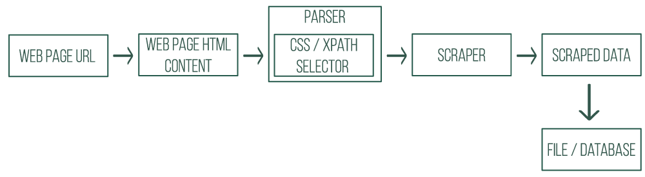
Conception
Architecture of Web Scraper
Notes:
Now we will present a basic web scraper architecture it starts with the web page url that is converted into its html content than using css and xpath selector we can parse small amount of data and when we are finished with parsing we start scraping to generate scraped data that we will store in a file or a database

Slide 15

Conception
Actor
Human Resources Manager
Search candidates
Navigate candidates
Filter candidates
Sort candidates
Notes:
For our solution we have a main actor that is ….

Slide 16
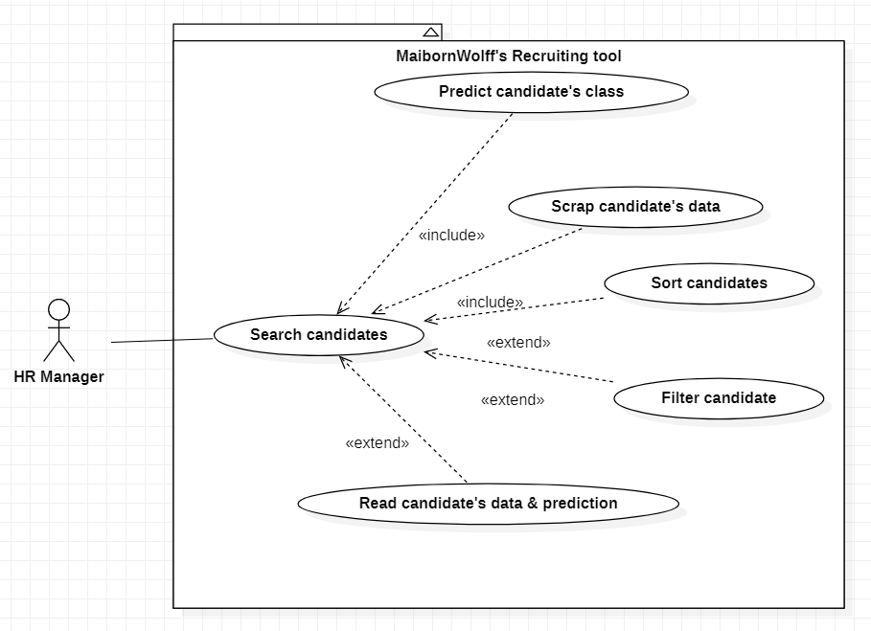
Conception
General Use Case
Notes:
Now we will present the general use case
Our HR manager can search candidates, to do that we need to scrap fresh data and predict candidates class than we can navigate or sort candidates or even filter them.

Slide 17
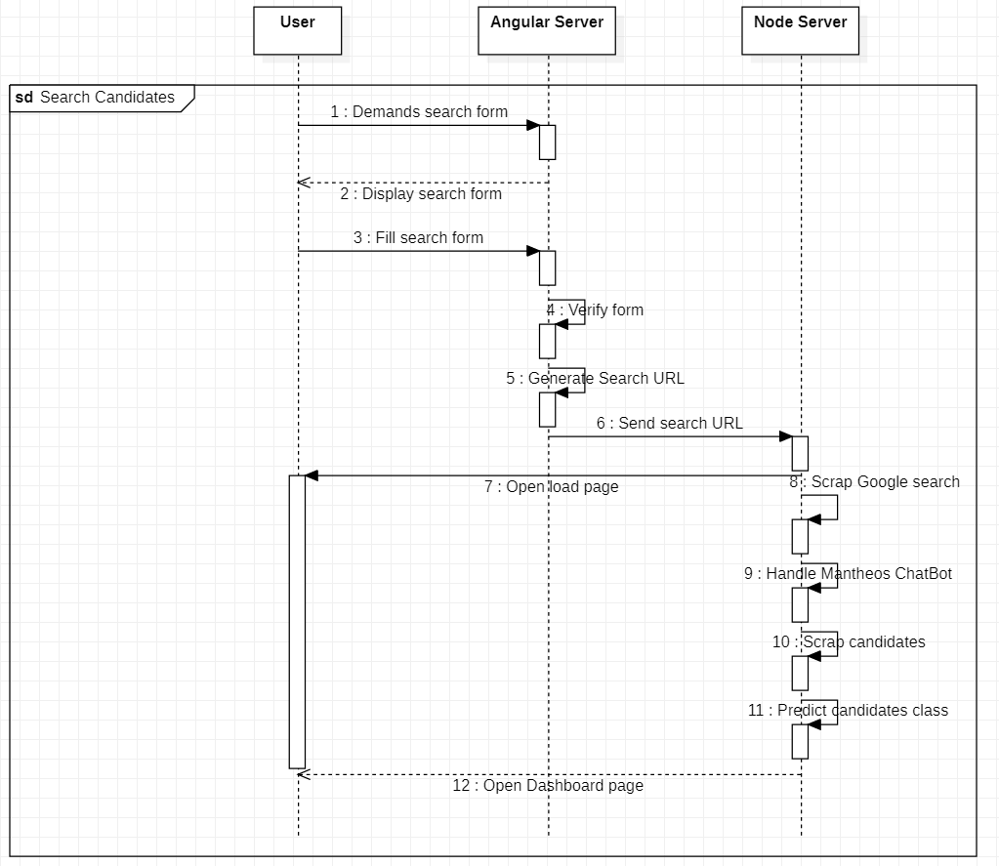
Conception
Sequence diagram
Use case « Search candidates »
Notes:
This figure represents sequence diagram for search candidates case

Slide 18
Realization
Notes:
Now we will present the realization phase

Slide 19






Realization
Work environment
Notes:
To realize our project we used VS code as text editor and Jupyter notebook to develop our model.
StarUml as a tool help us for the conception. Therefore, we used node.js to develop our server, angular for our user interface and python for Machine learning part.

Slide 20
Realization
Predictive Study
Used Libraries
Pandas
Numpy
Matplotlib
Scikit-learn
Puppeteer
Notes:
We used these libraries to create our project:
Pandas is a fast, powerful library which convert an entire data table into a NumPy matrix array.
NumPy is a library to manipulate matrices and arrays in multiple dimensions.
Matplotlib is a library destined for visualizing charts.
Scikit-learn is a library that features various ML algorithm.
Puppeteer a node library that is used to automate scraping.

Slide 21
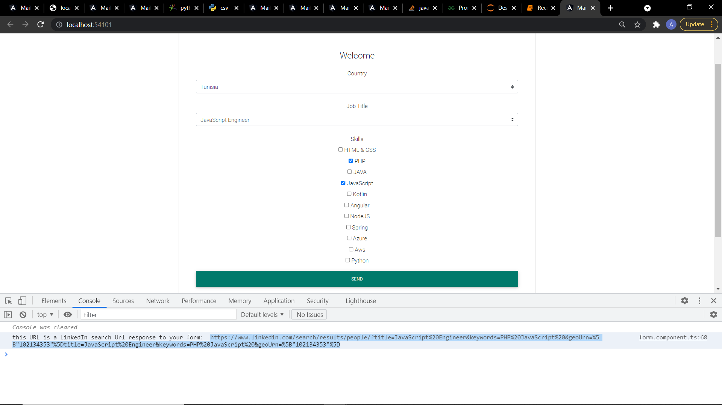
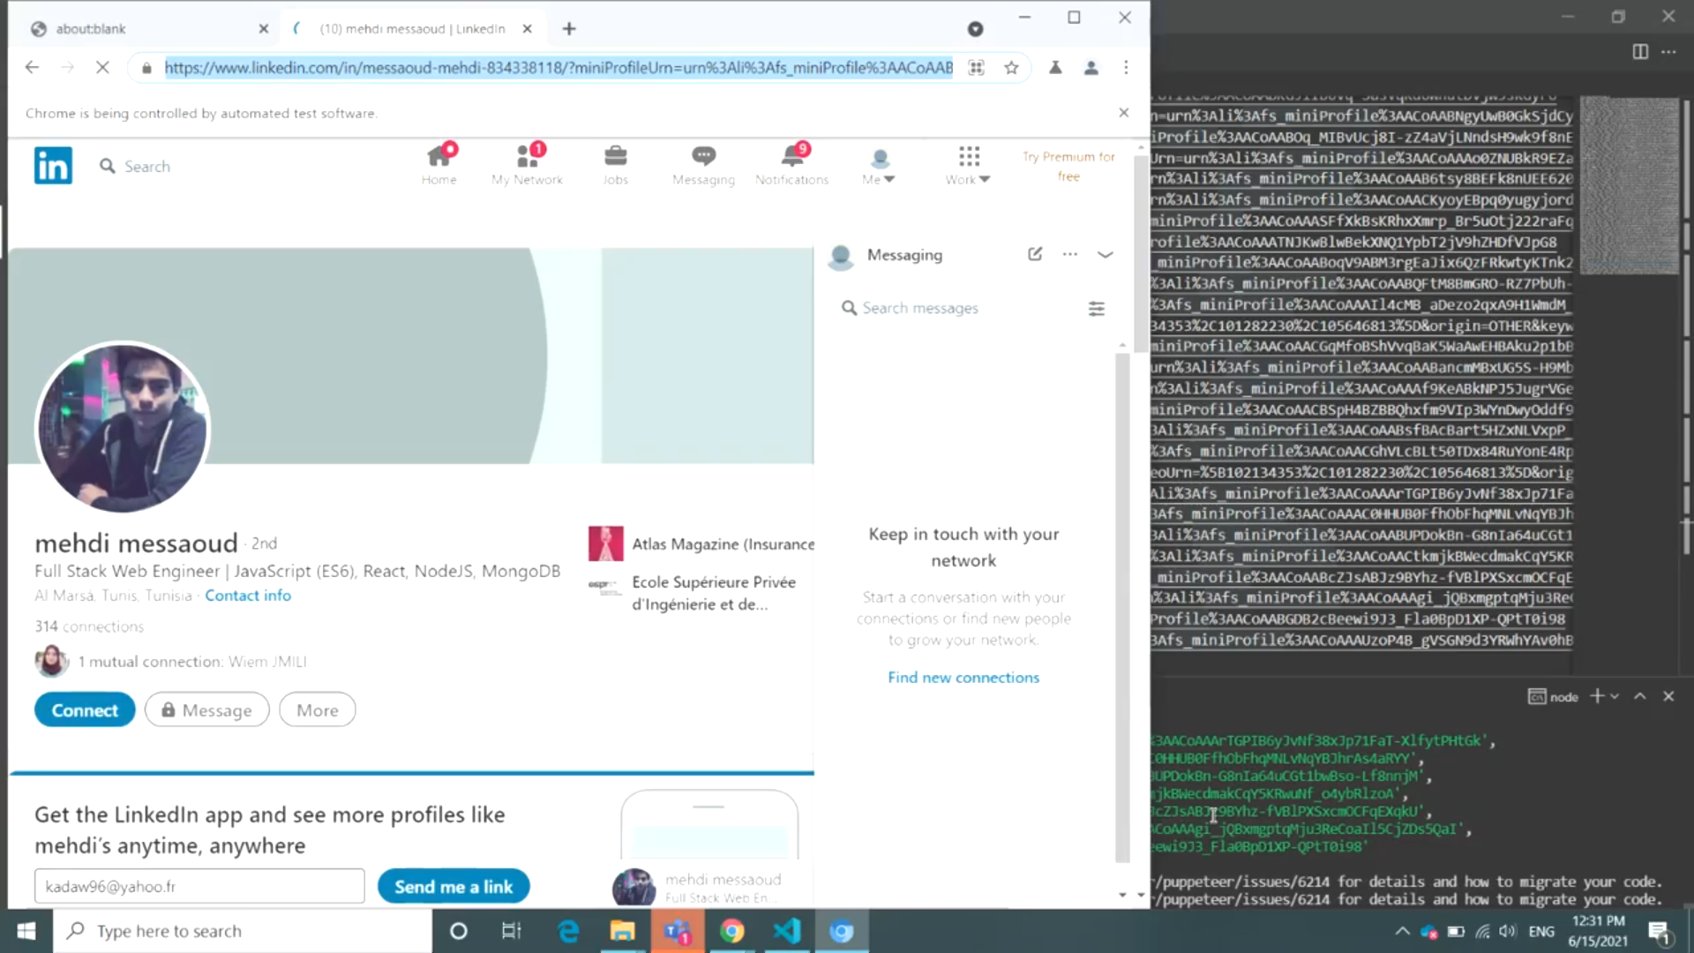
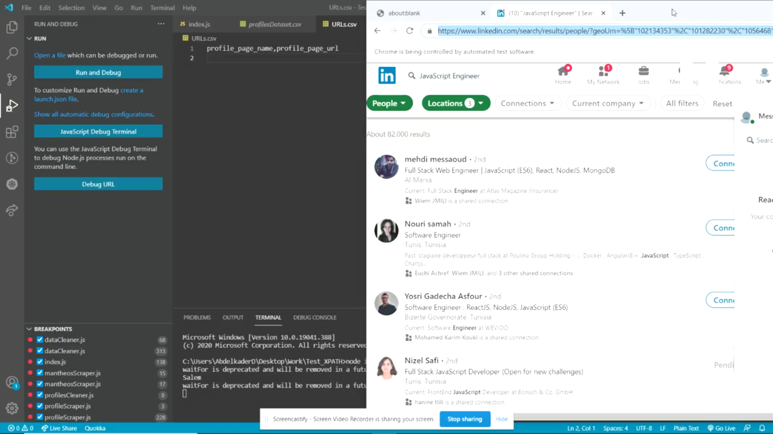
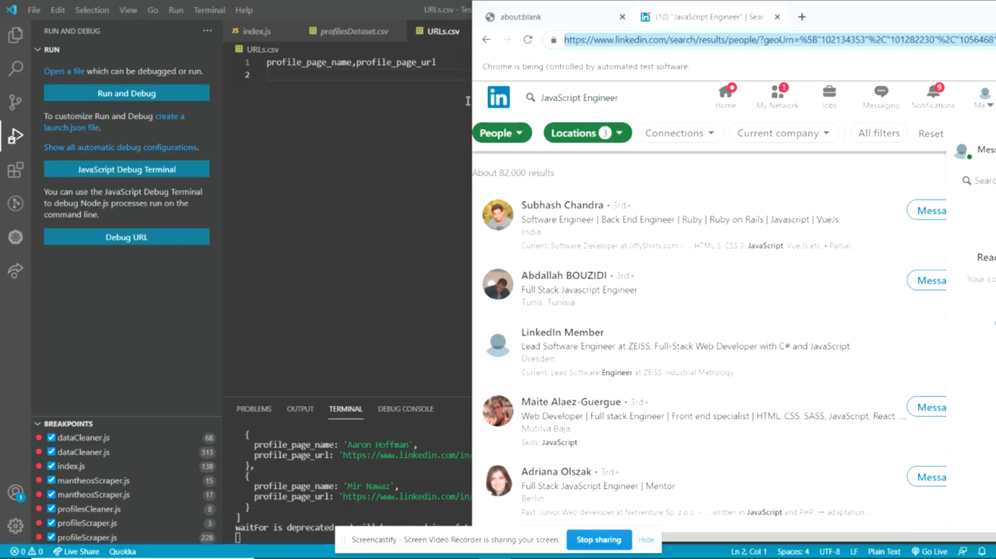
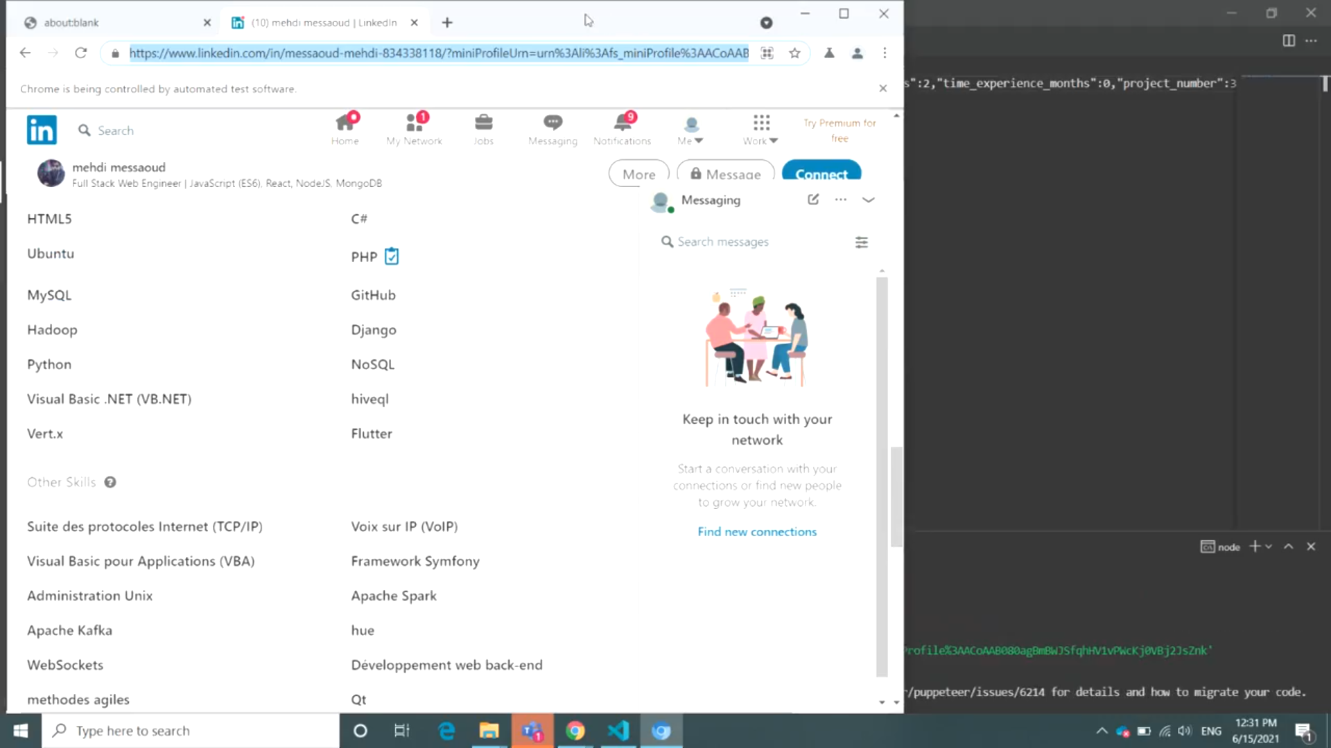
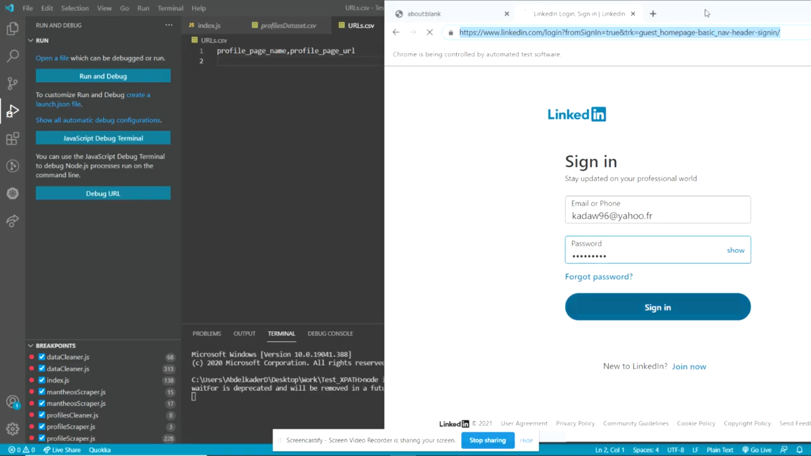
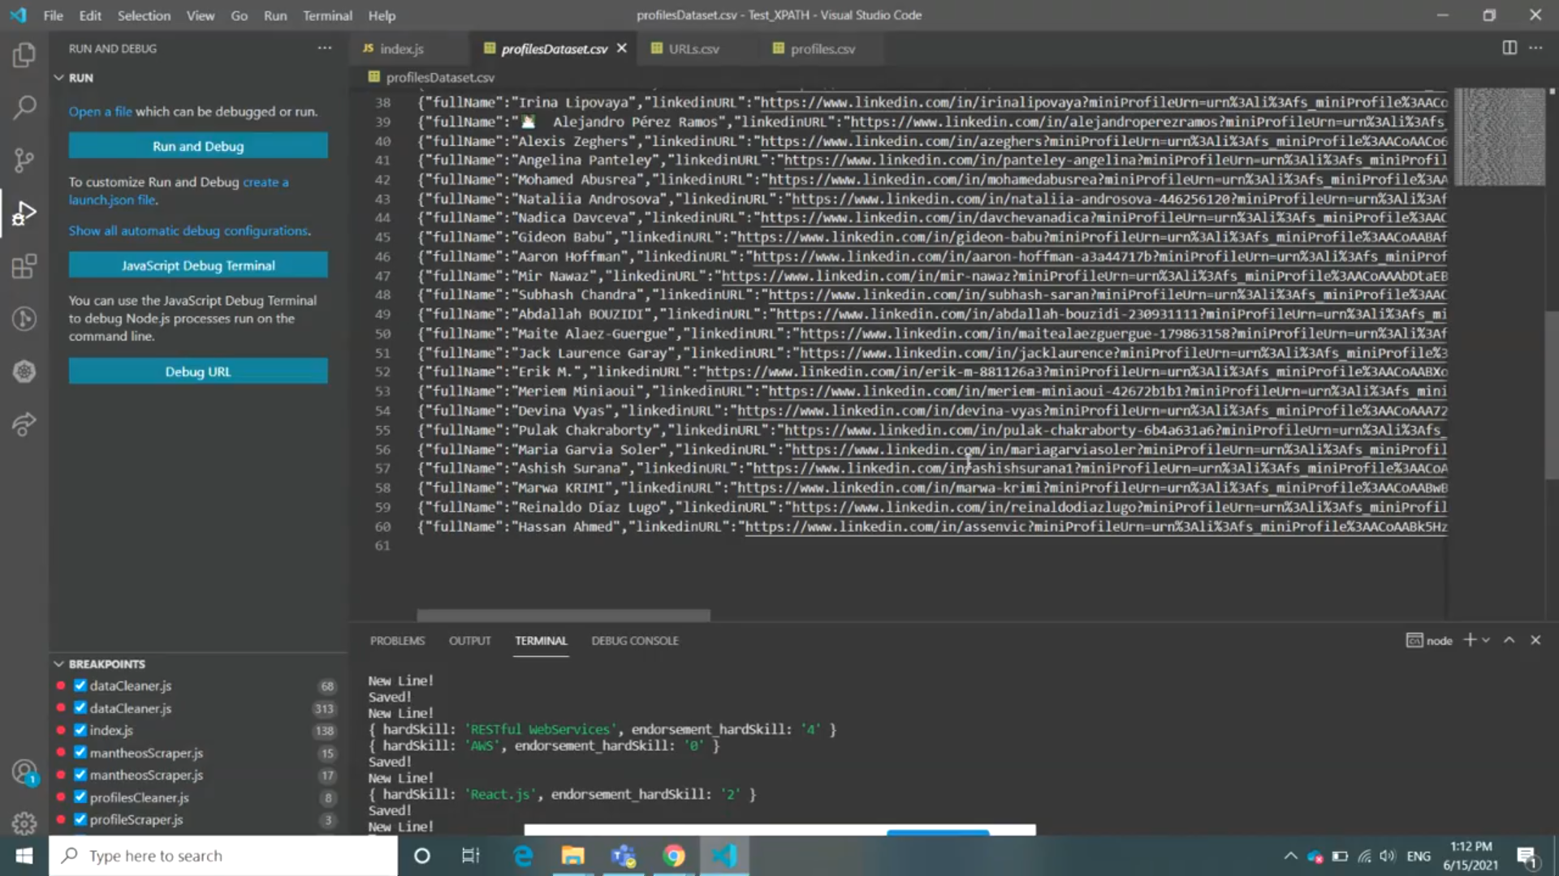
Realization
LinkedIn scraping

Slide 22
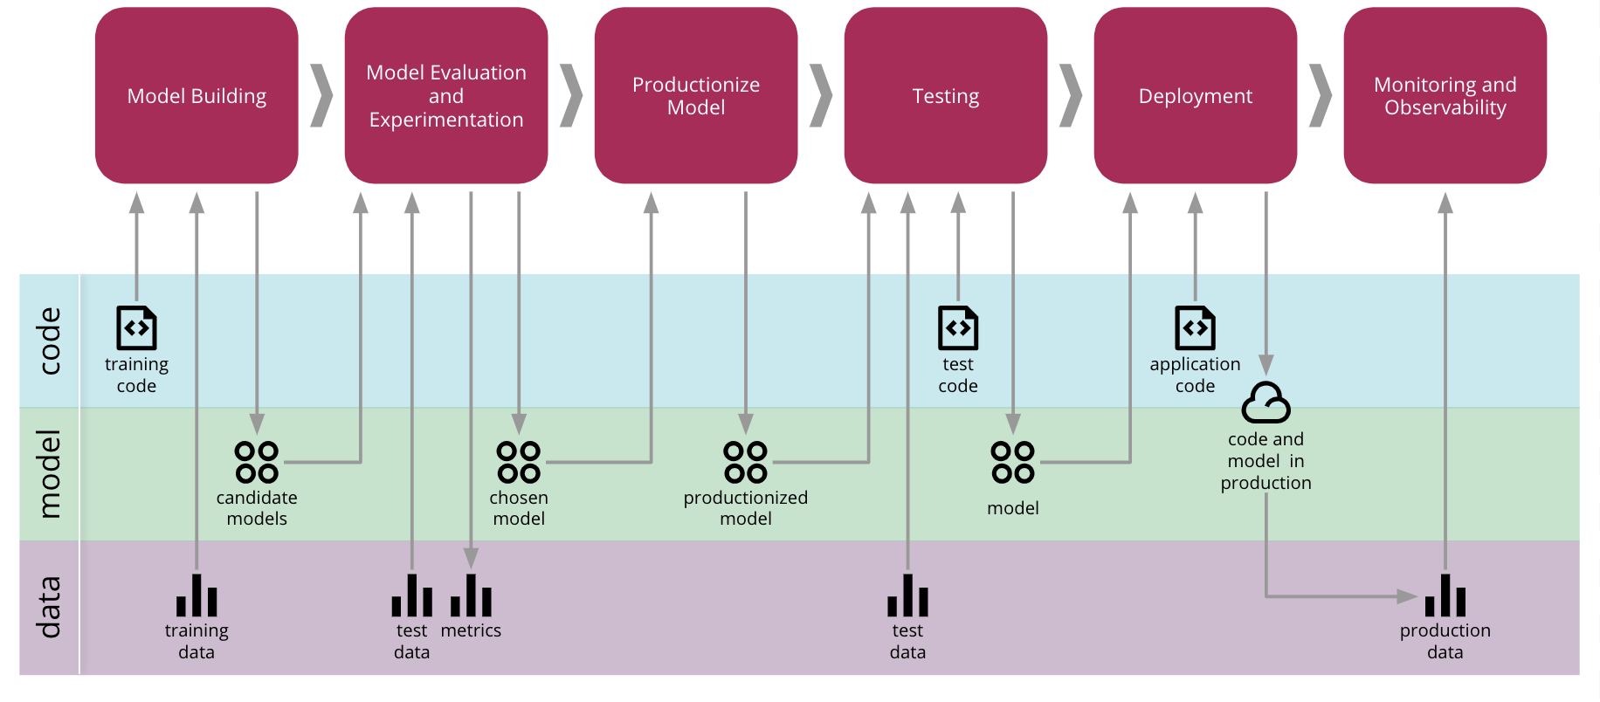
Realization
ML project

Slide 23
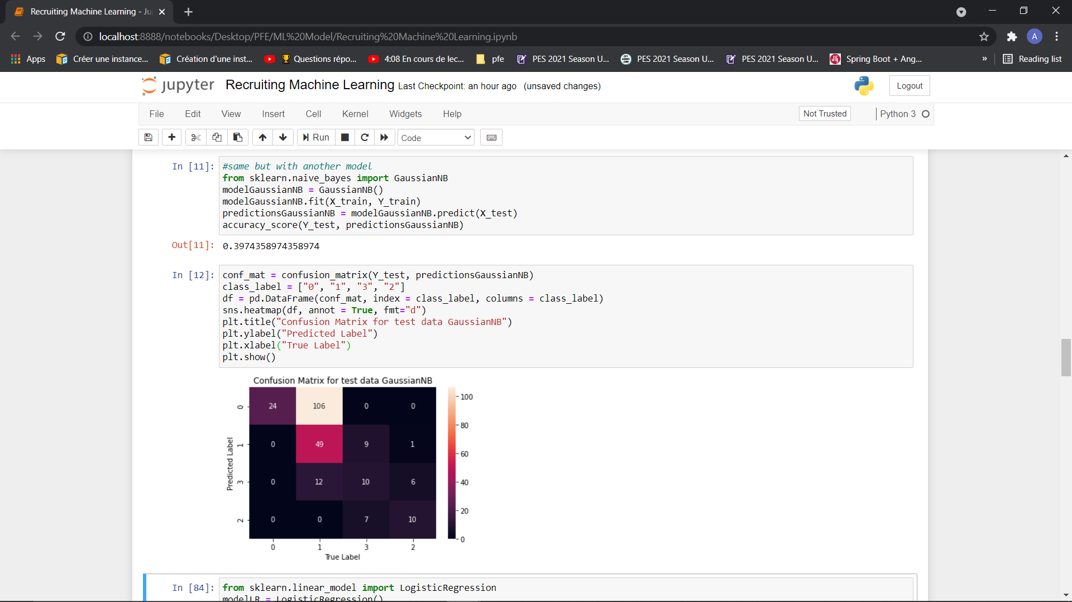
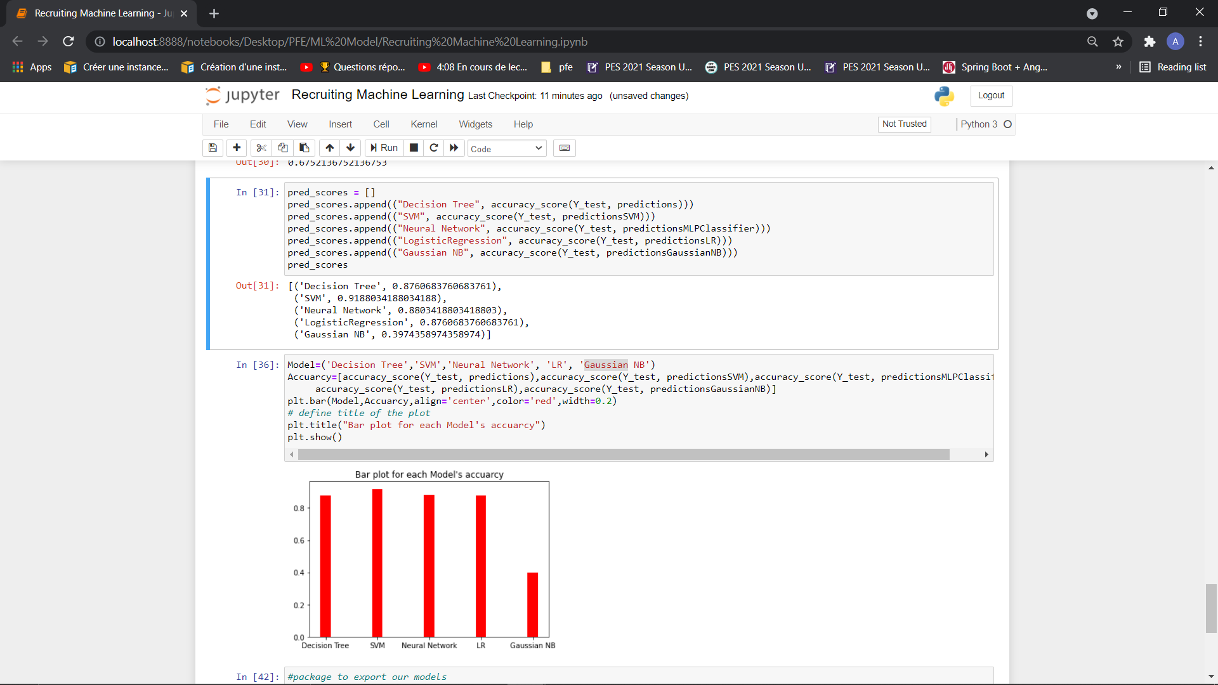
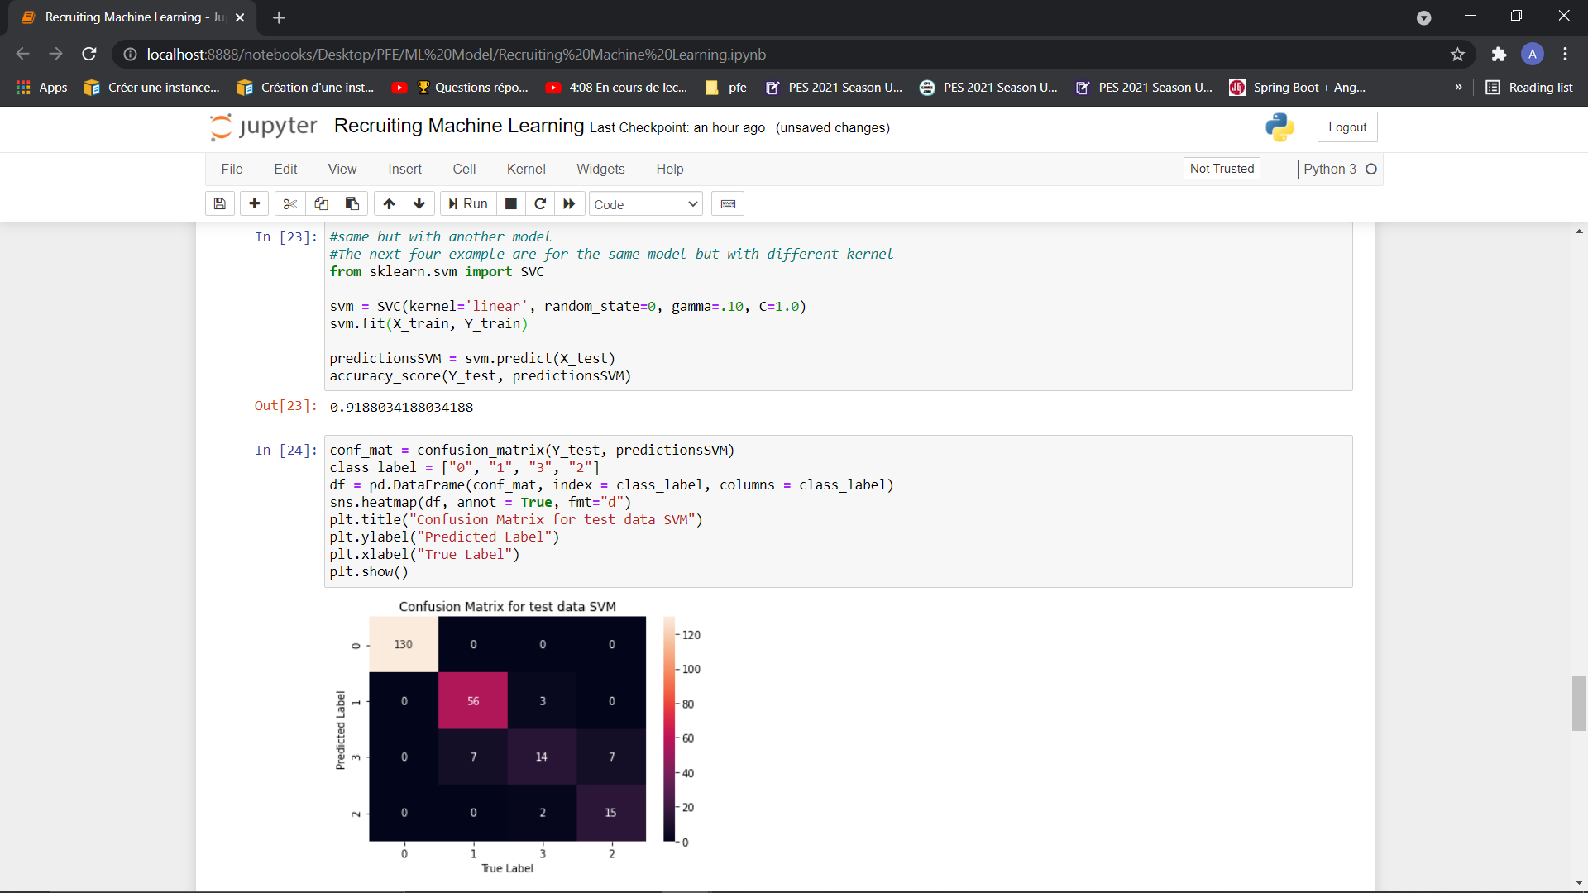
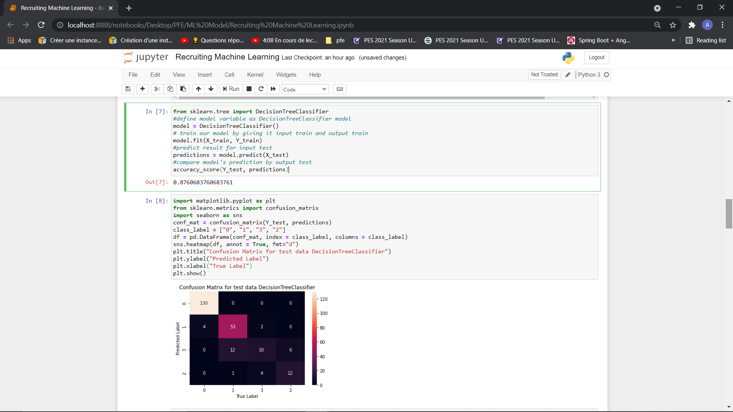
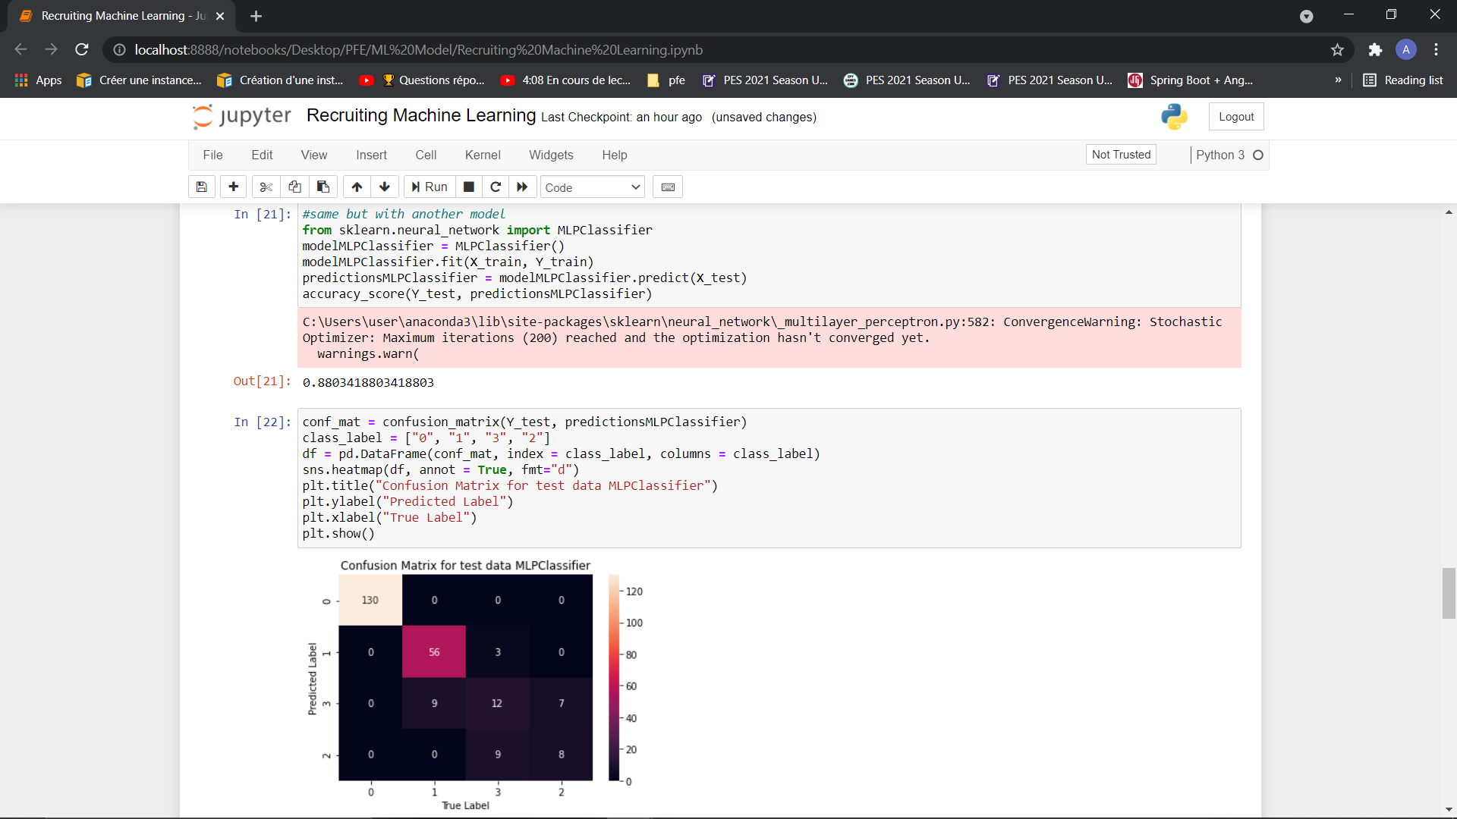
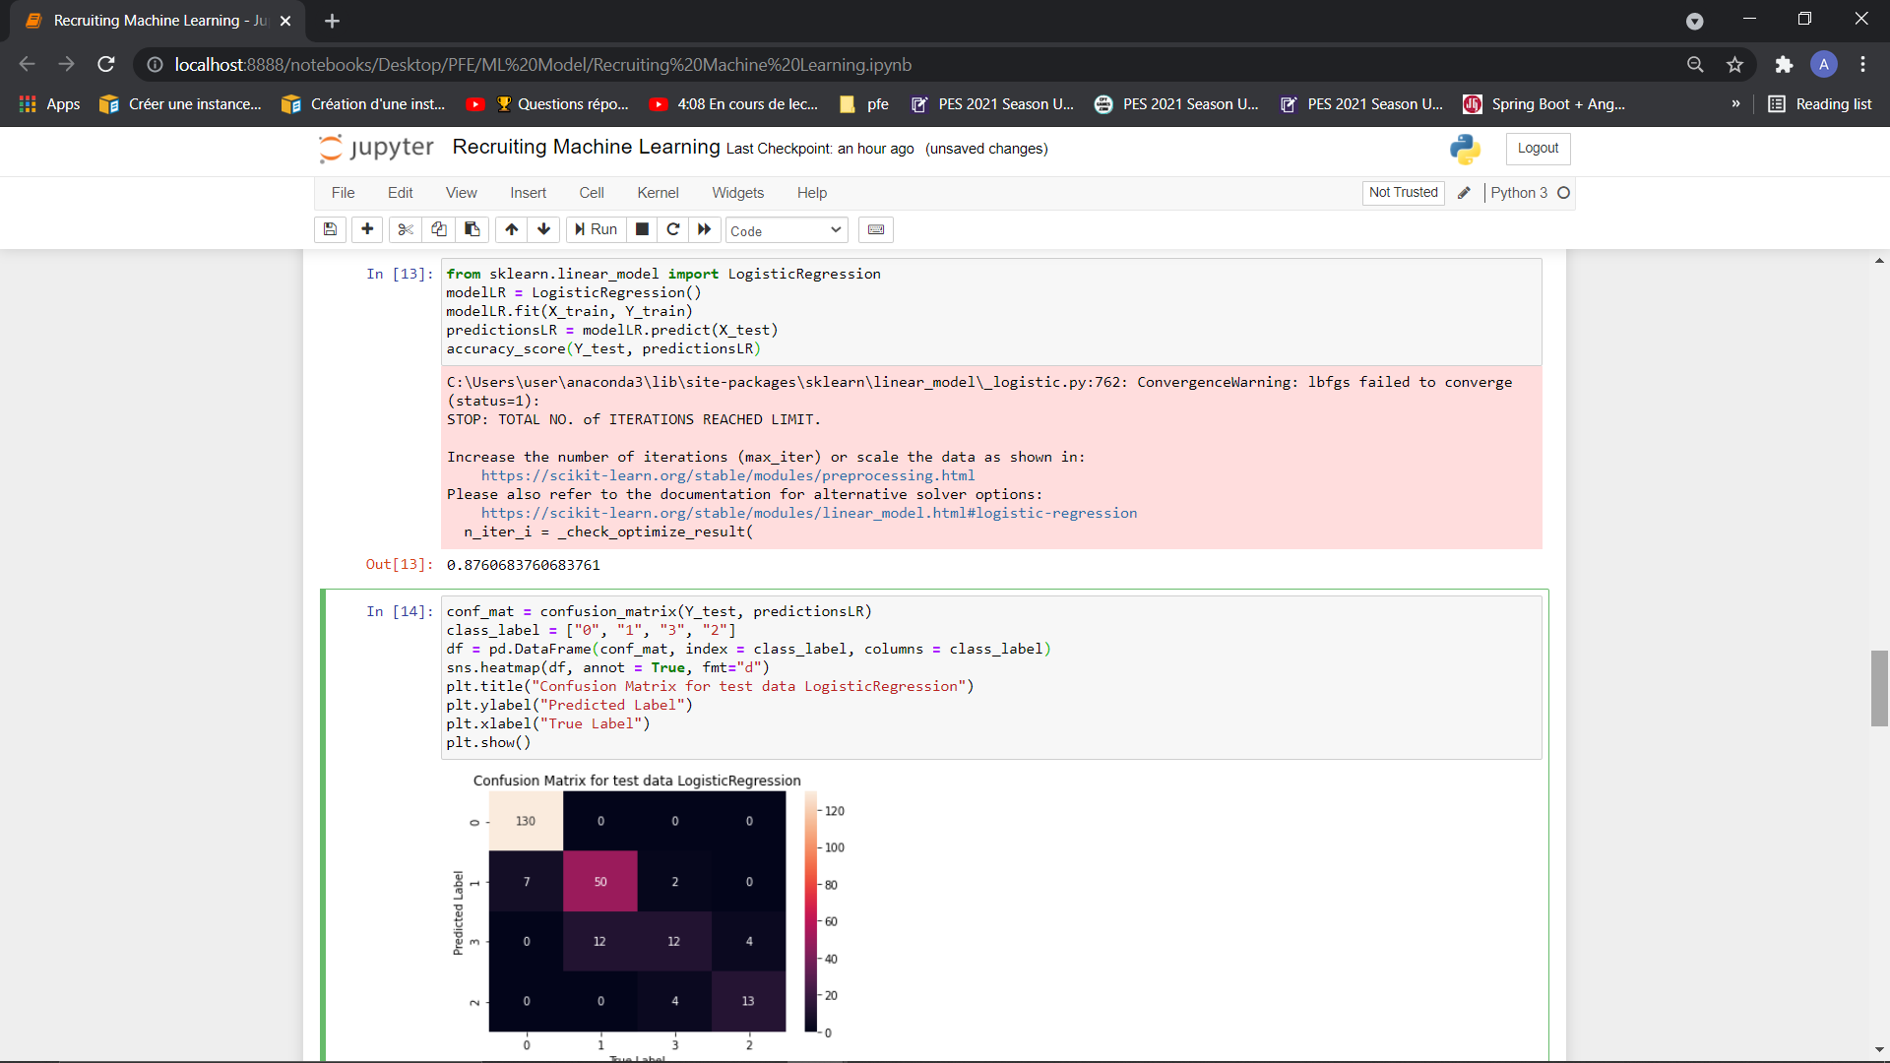
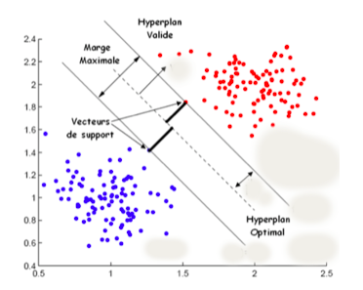
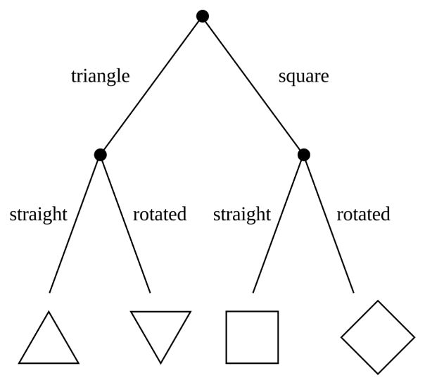
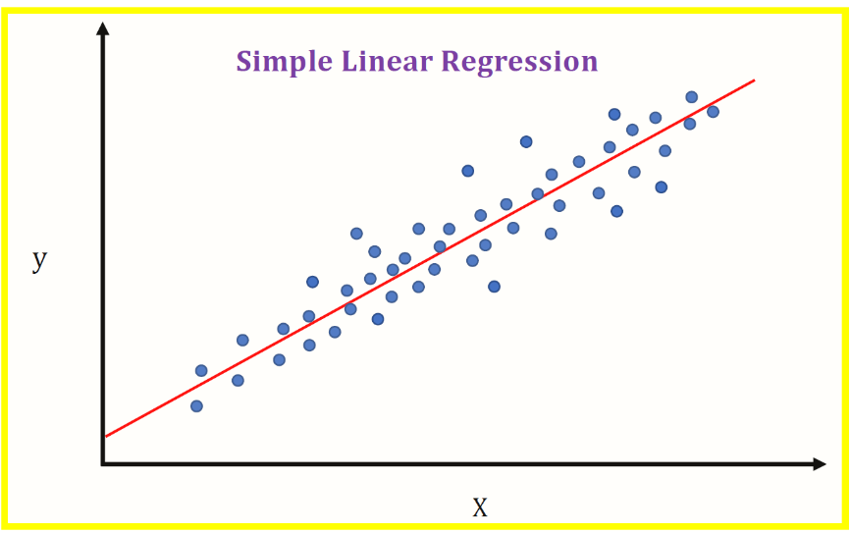
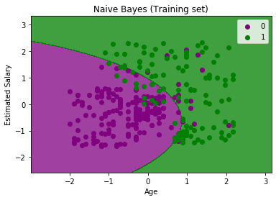

Realization
Ml Project
Naïves Bayes
Decsion Tree
SVM
Neural Network
Linear Regression

Slide 24
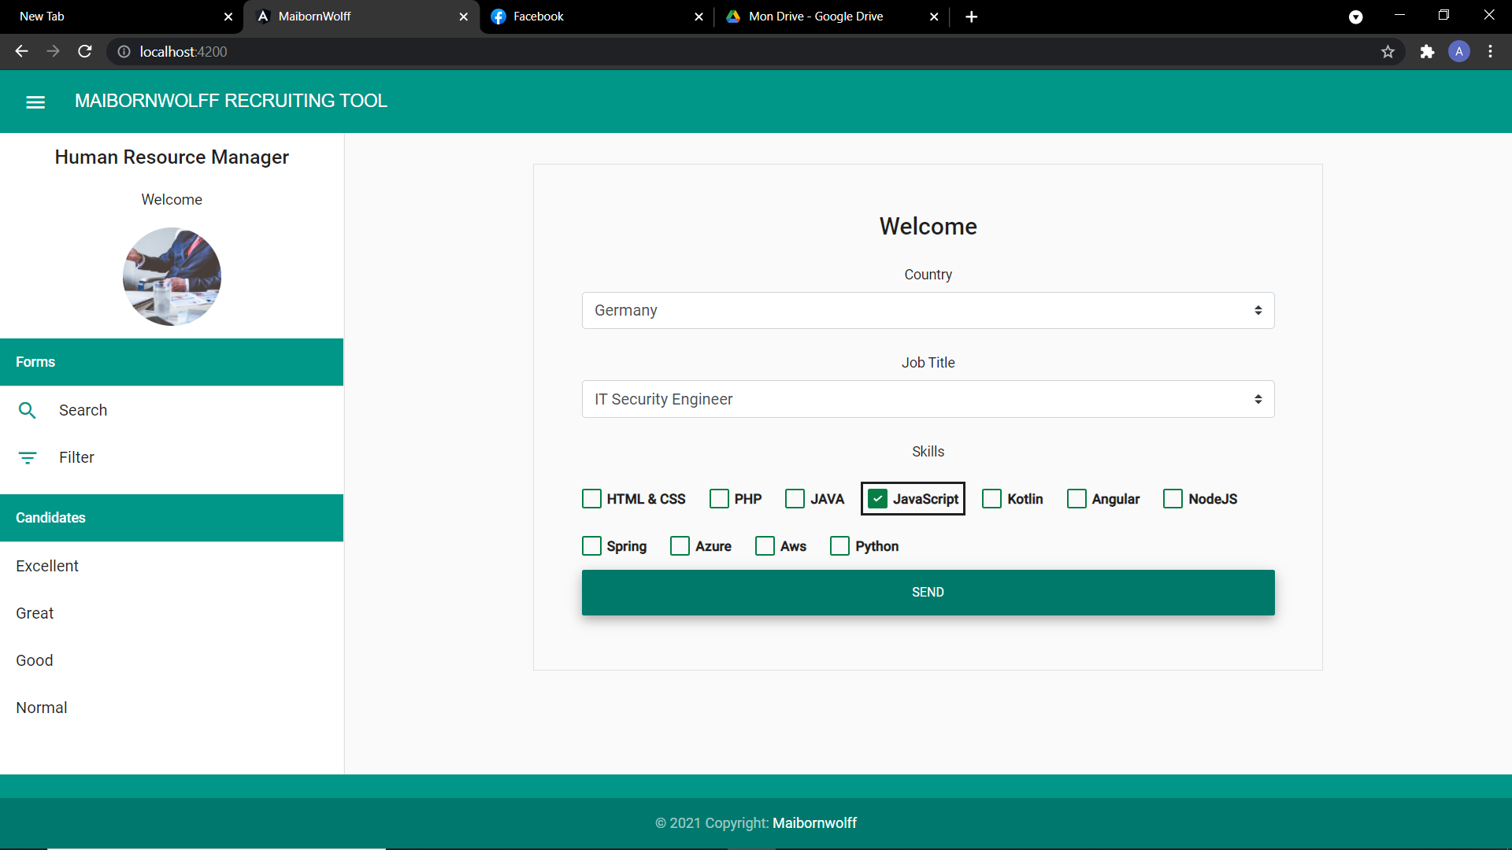
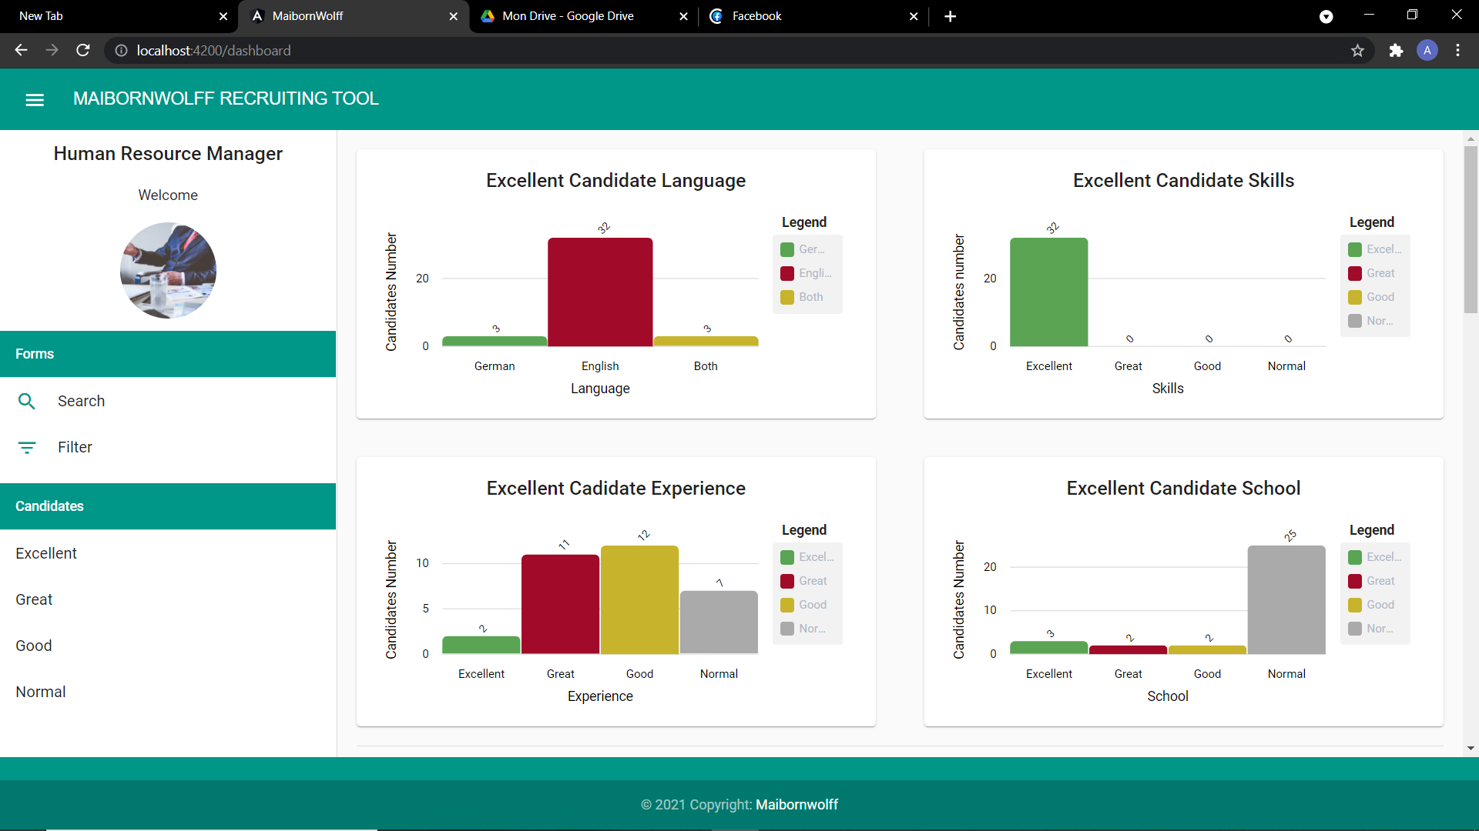
Realization
Menu

Slide 25
Realization
Search Form

Slide 26
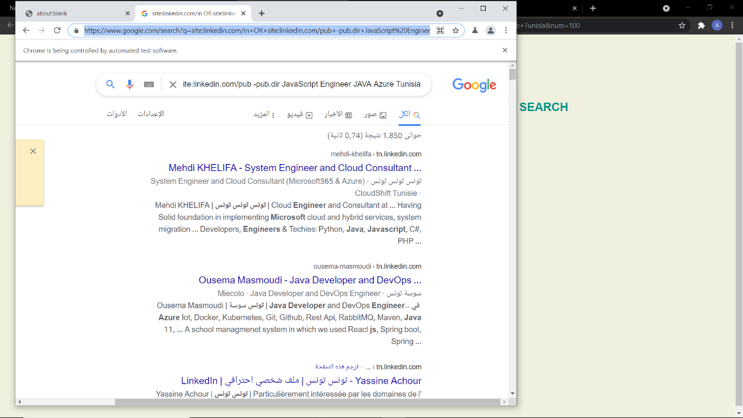
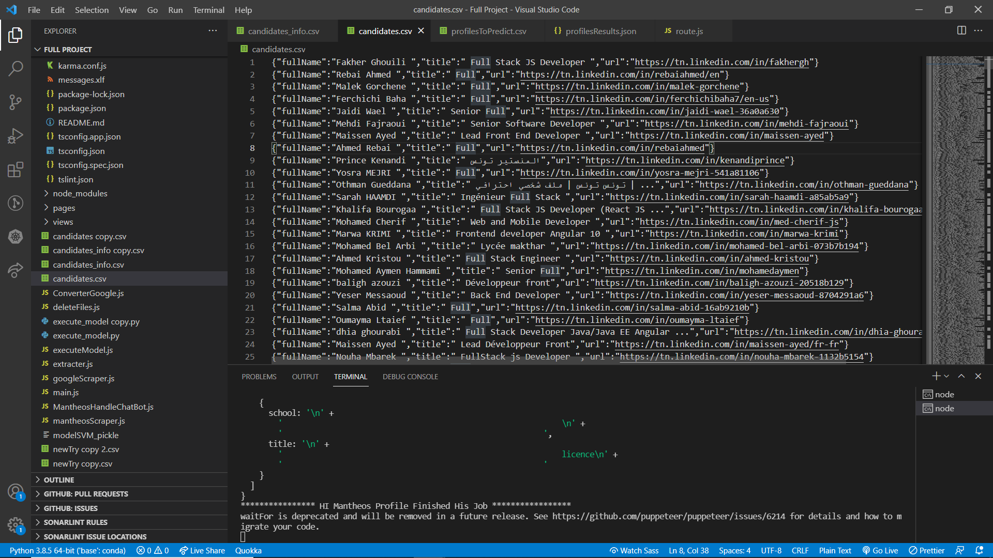
Realization
Scrap LinkedIn

Slide 27
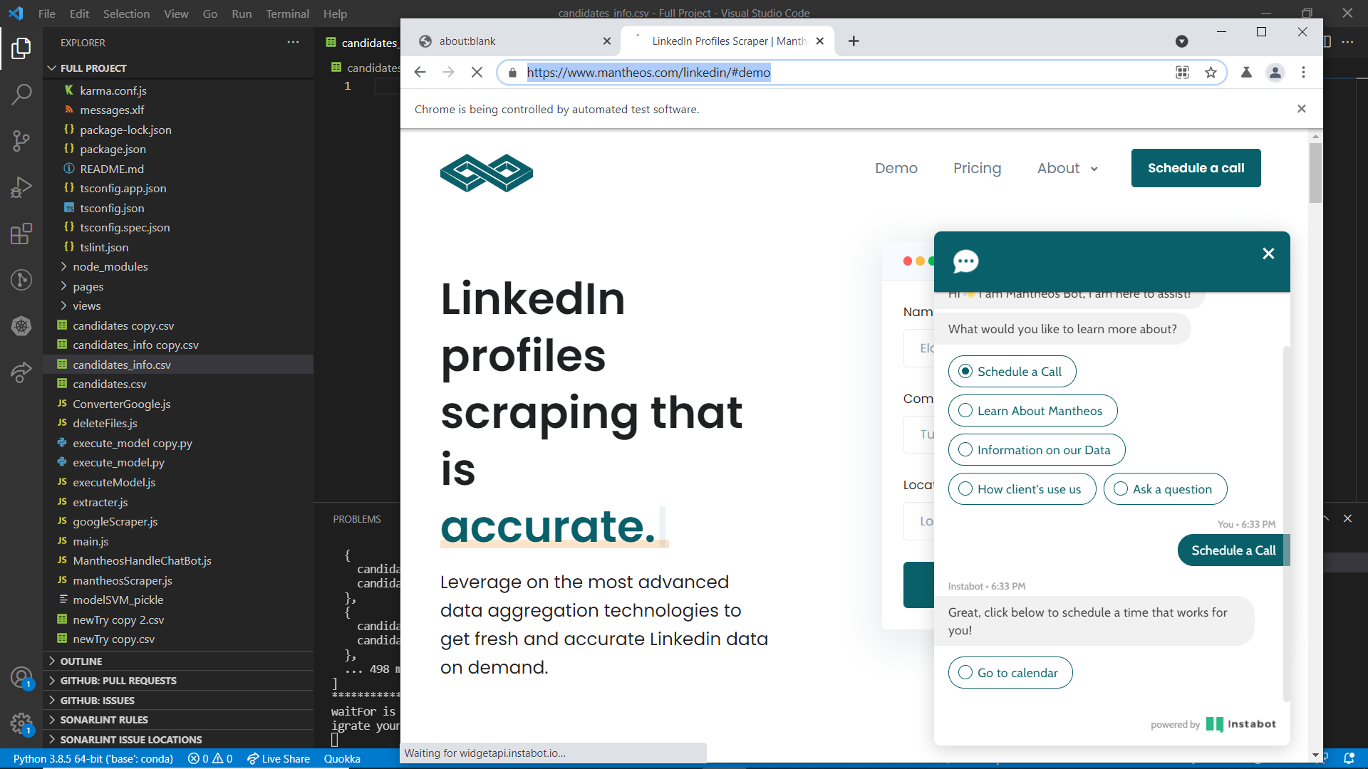
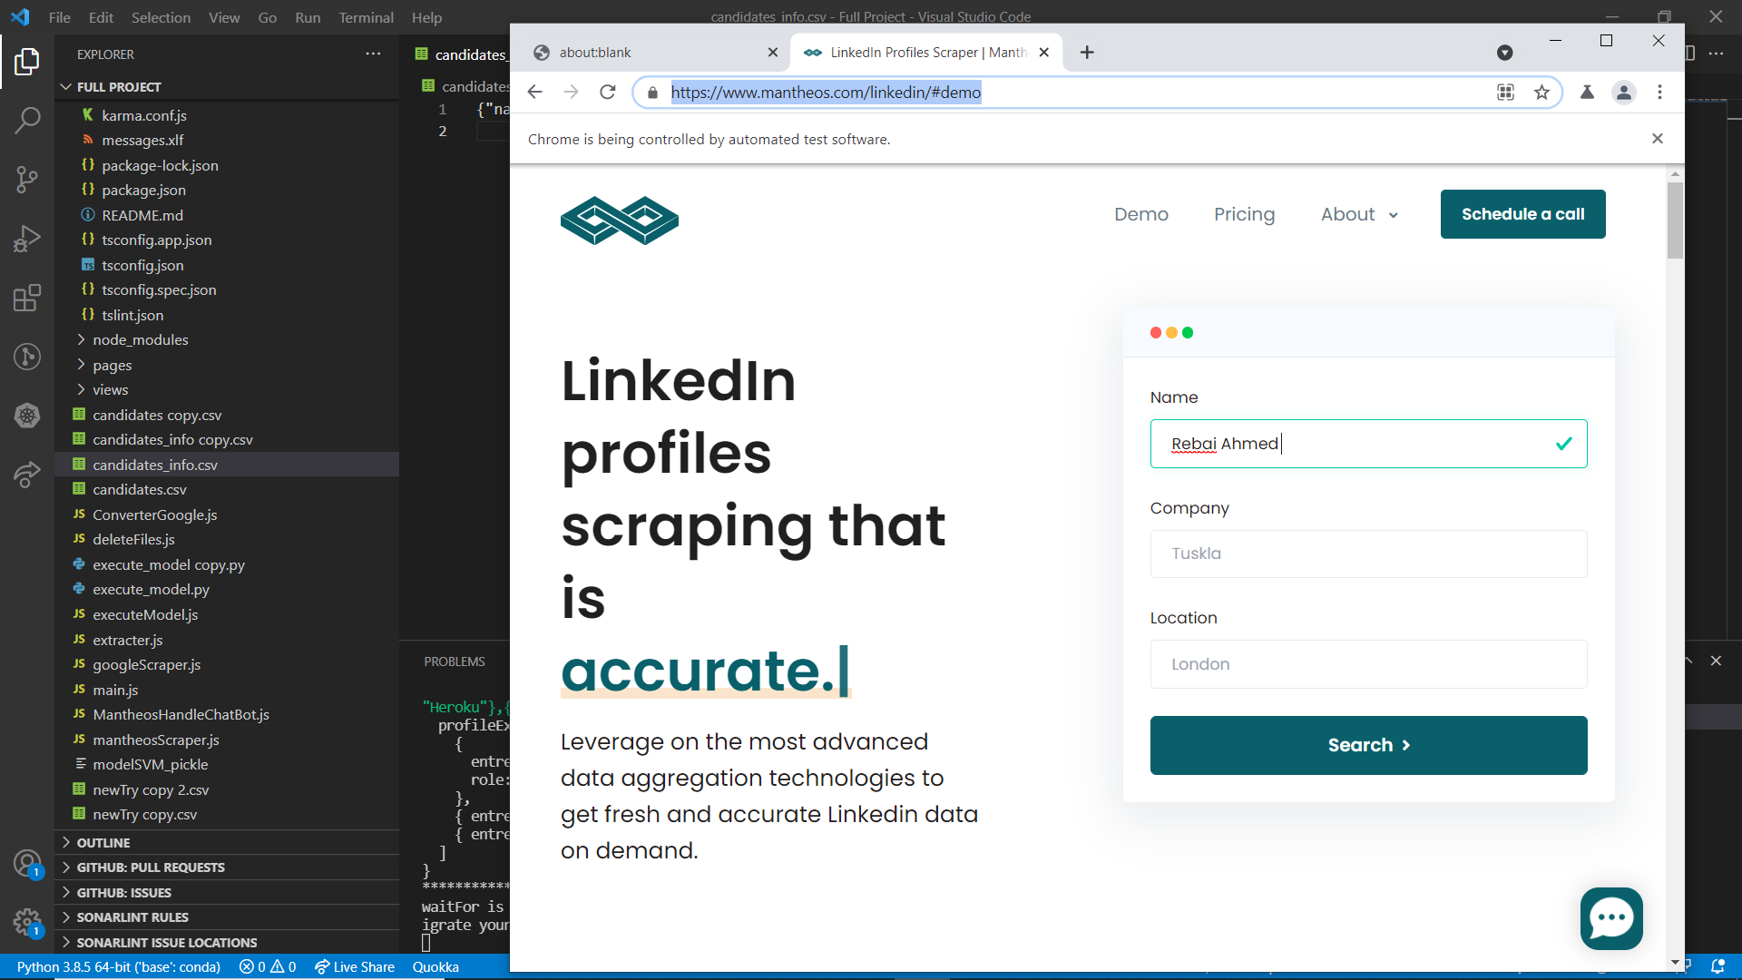
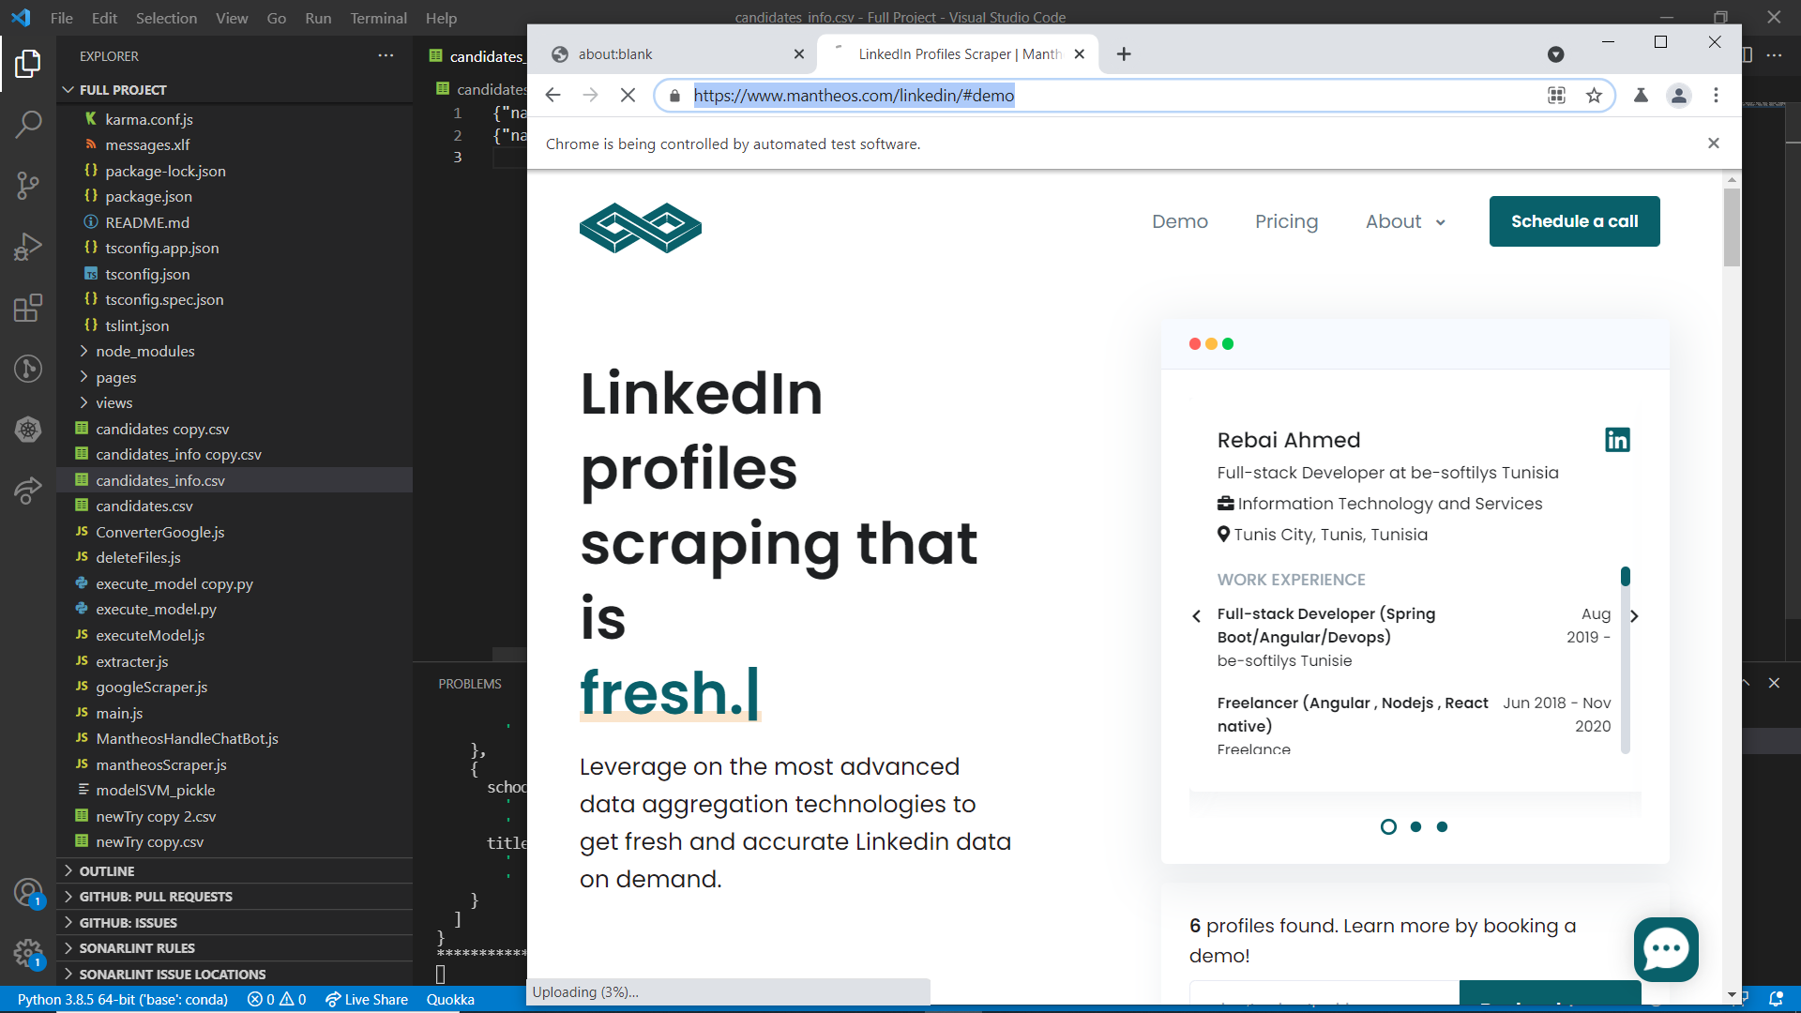
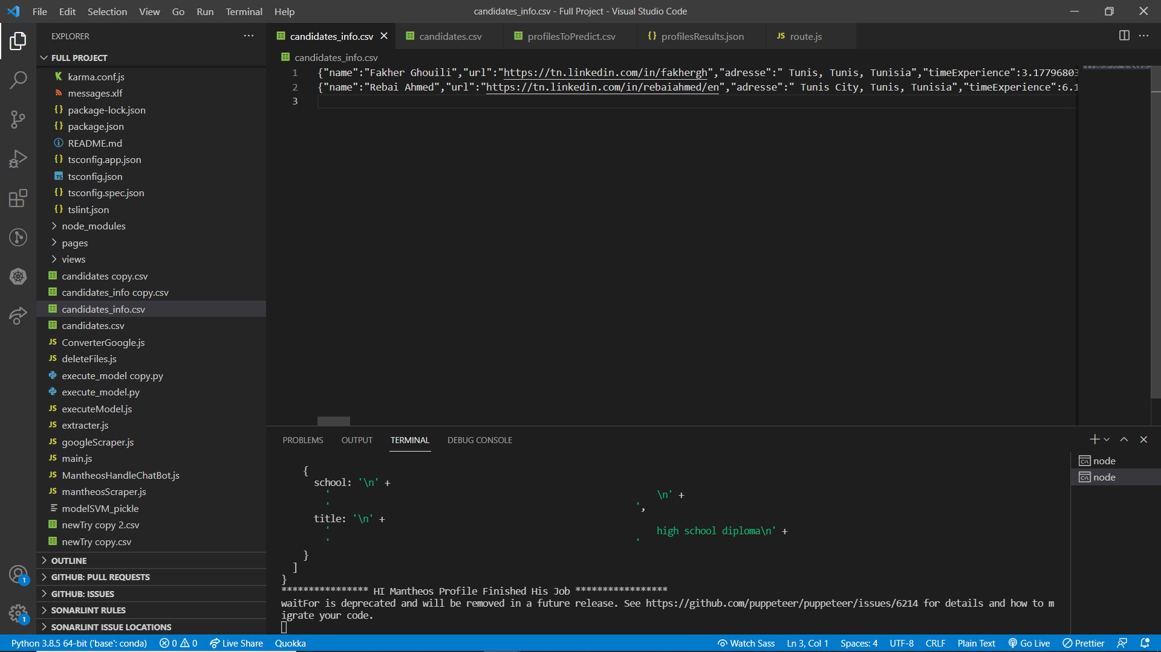
Realization
Scrap Manethoes

Slide 28
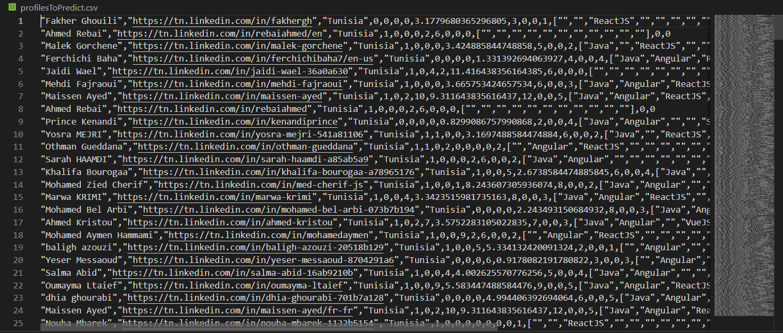
Realization
Extract Data

Slide 29
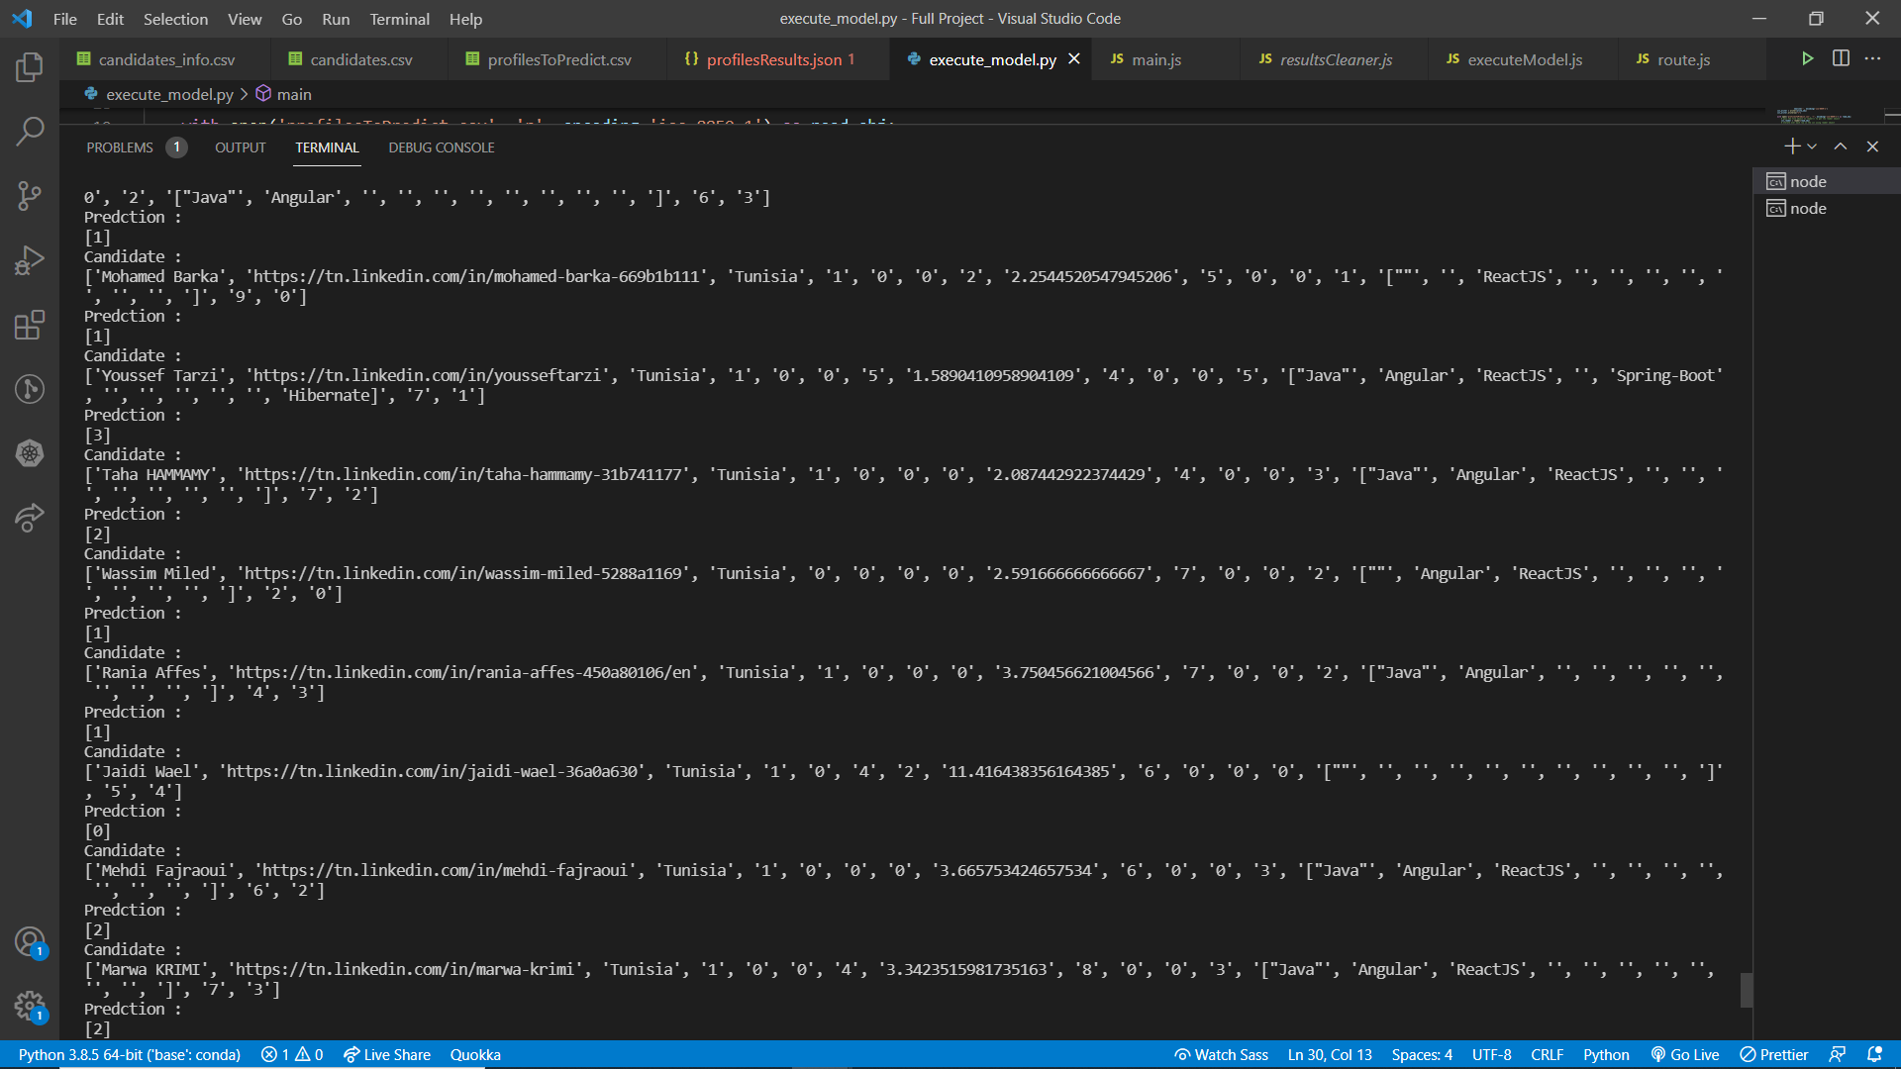
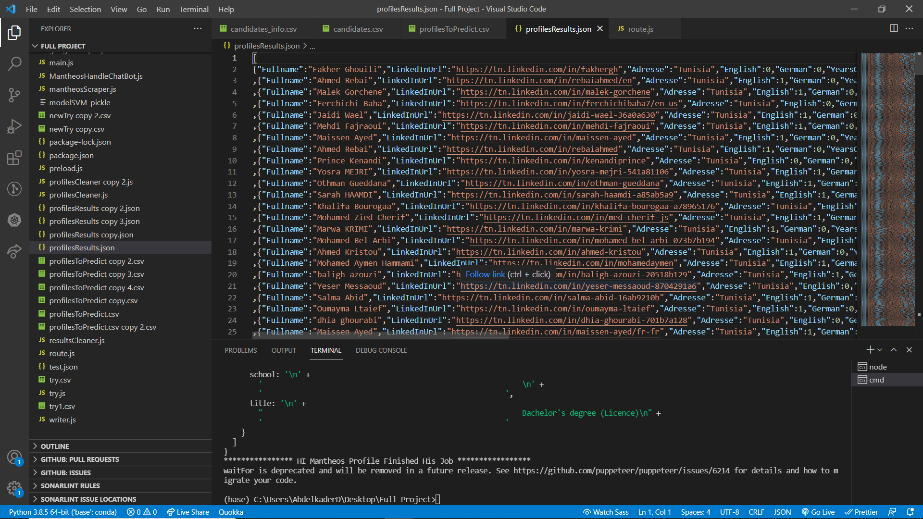
Realization
Predict candidates

Slide 30
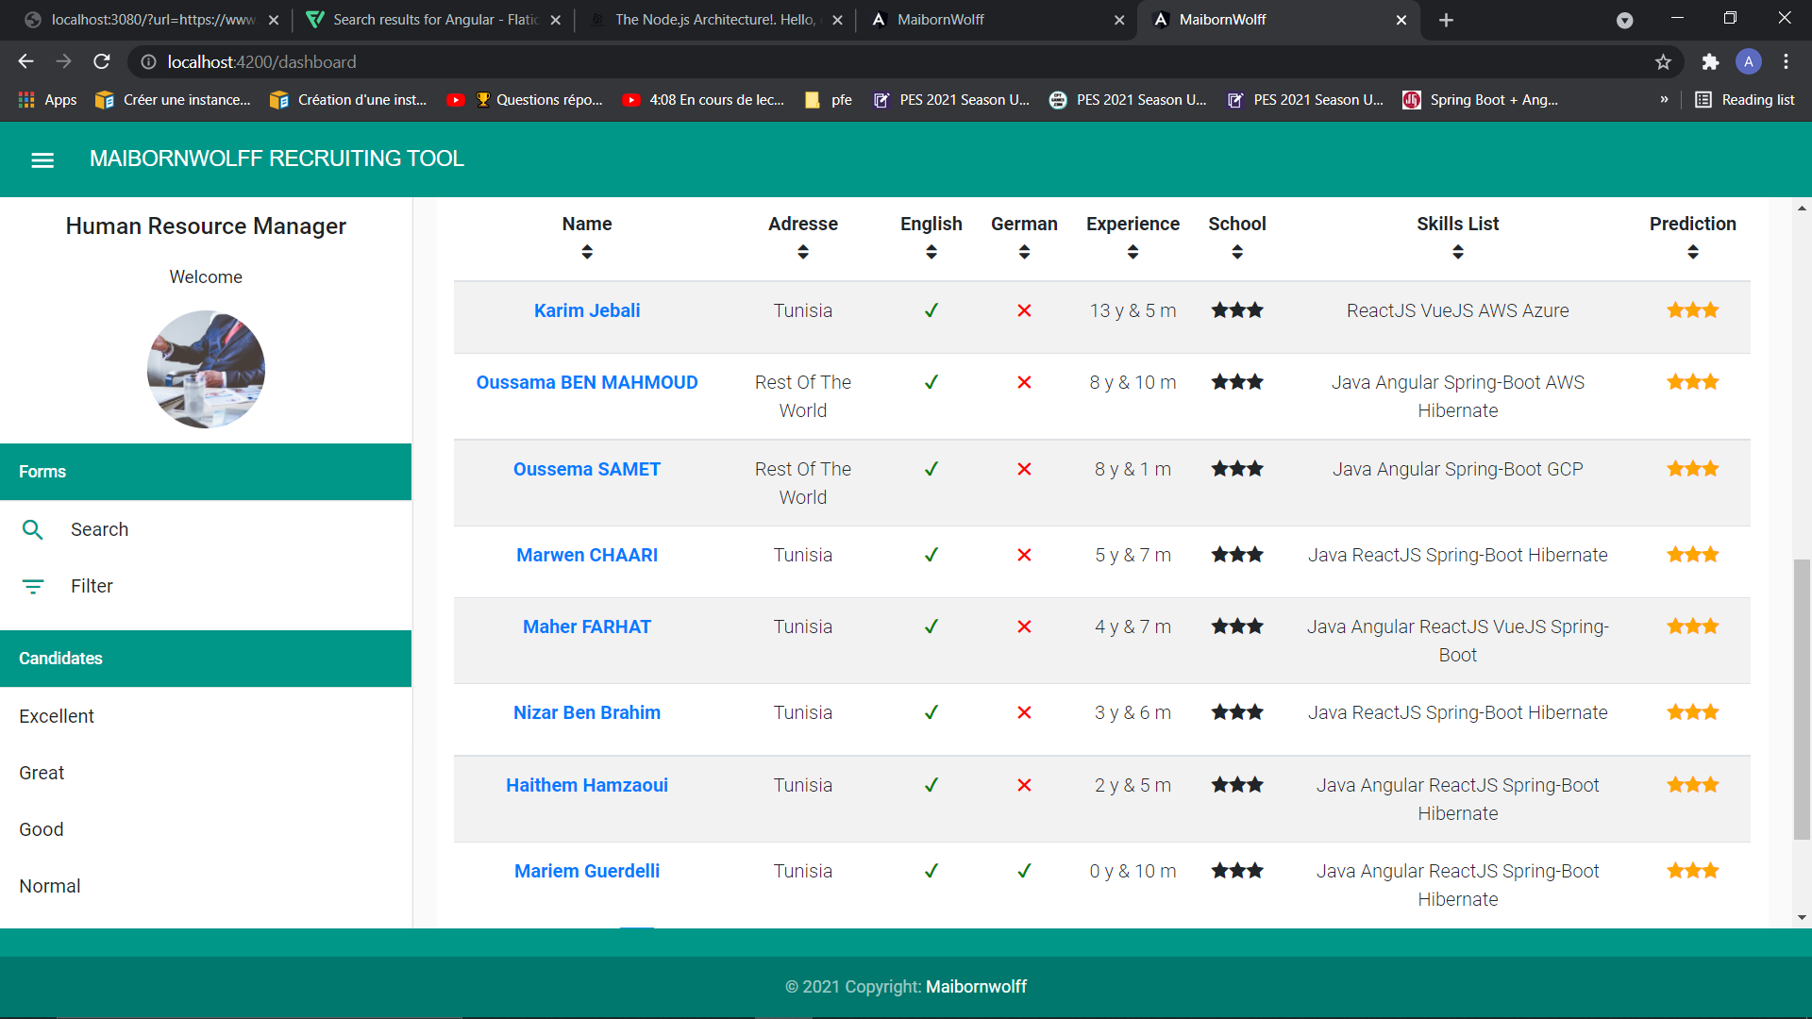
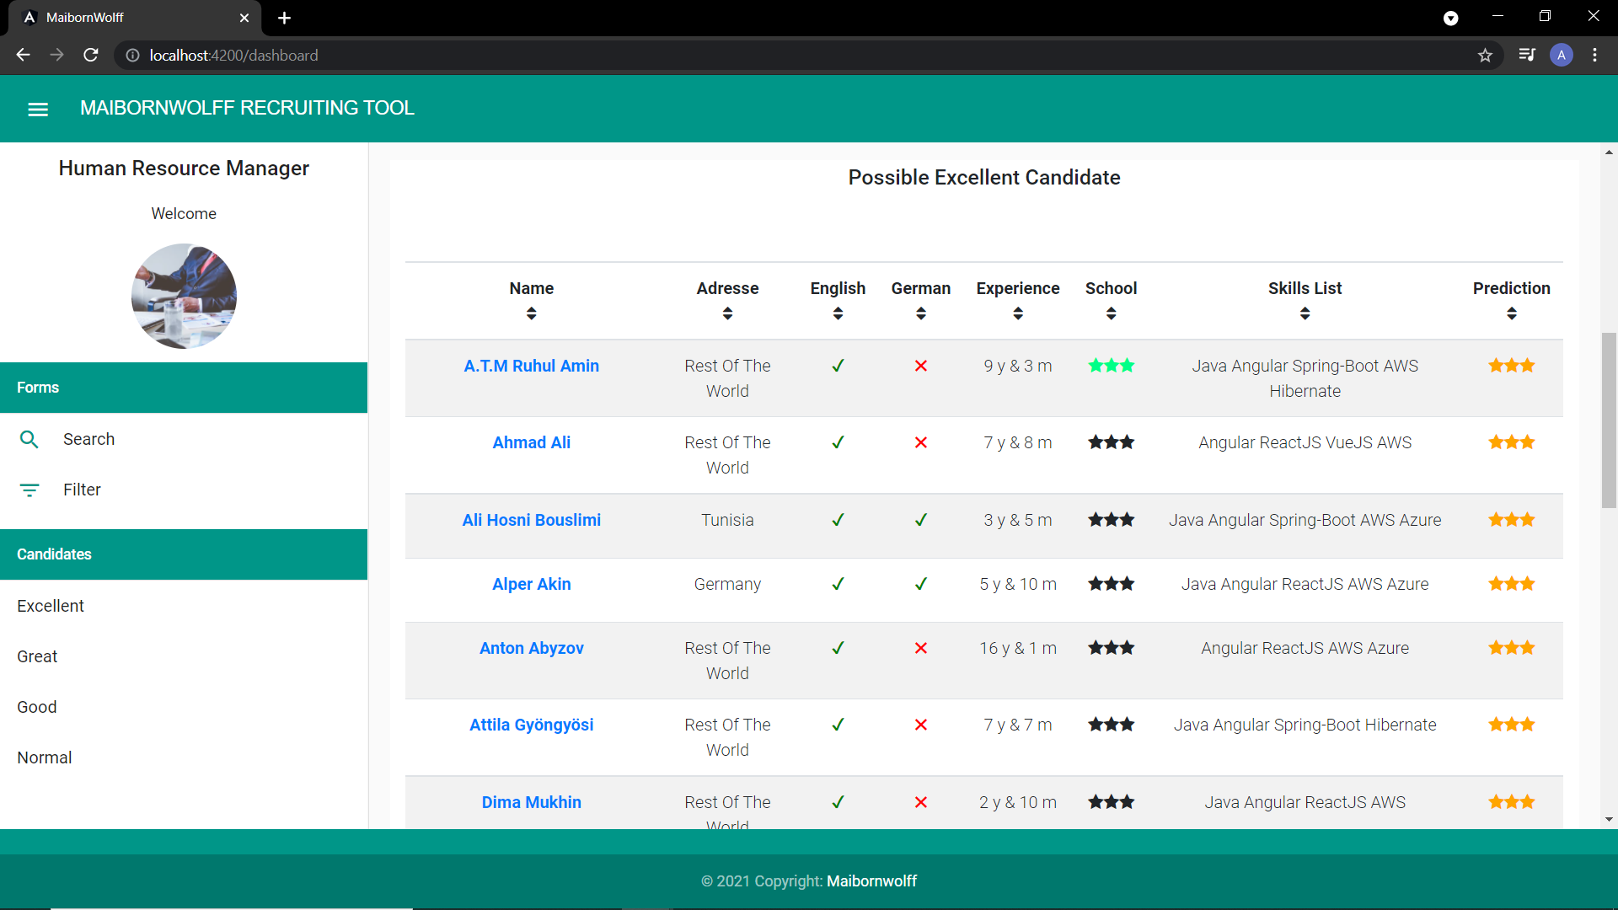
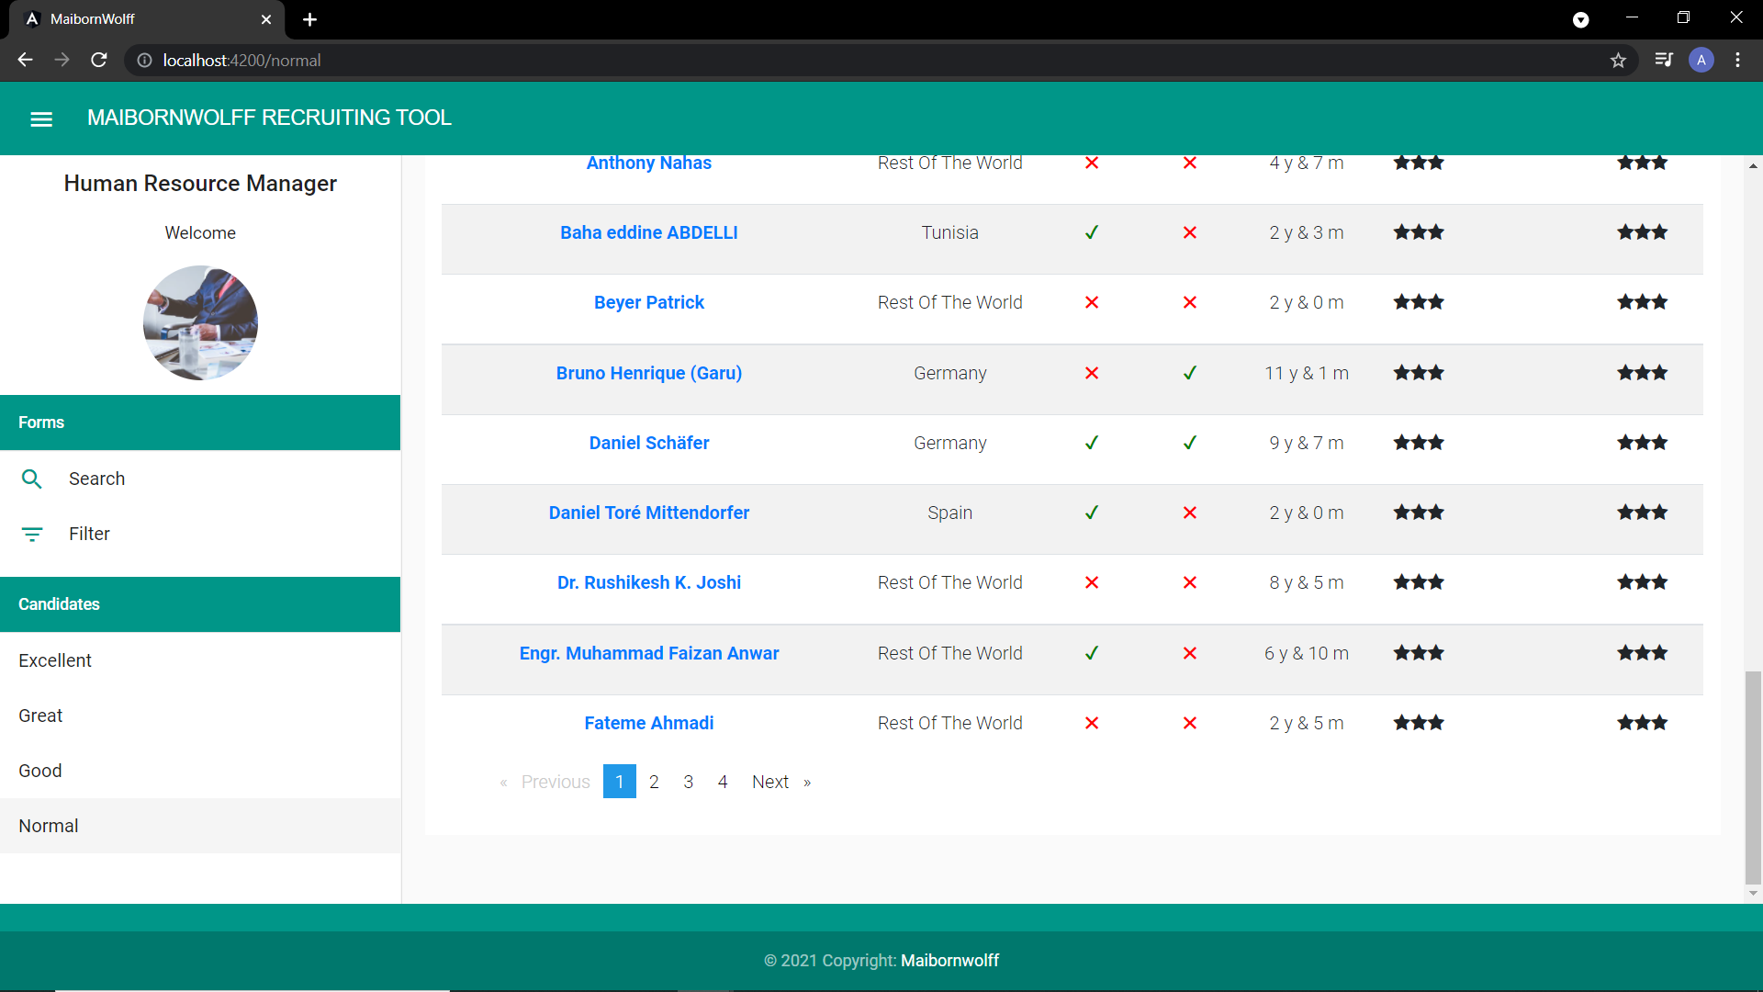
Realization
Sort candidates by experience

Slide 31
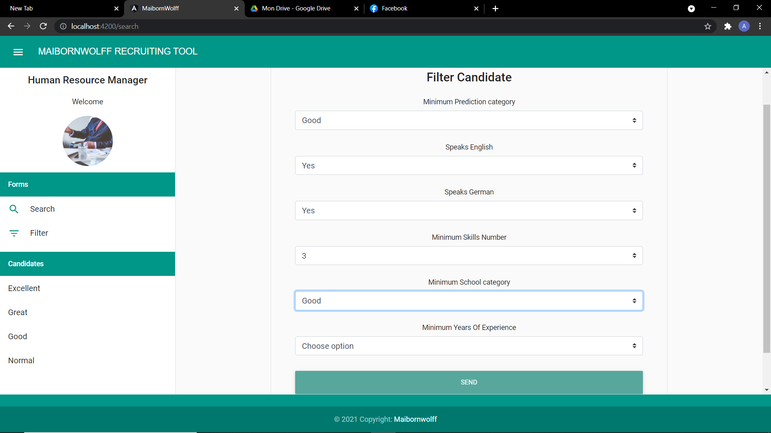
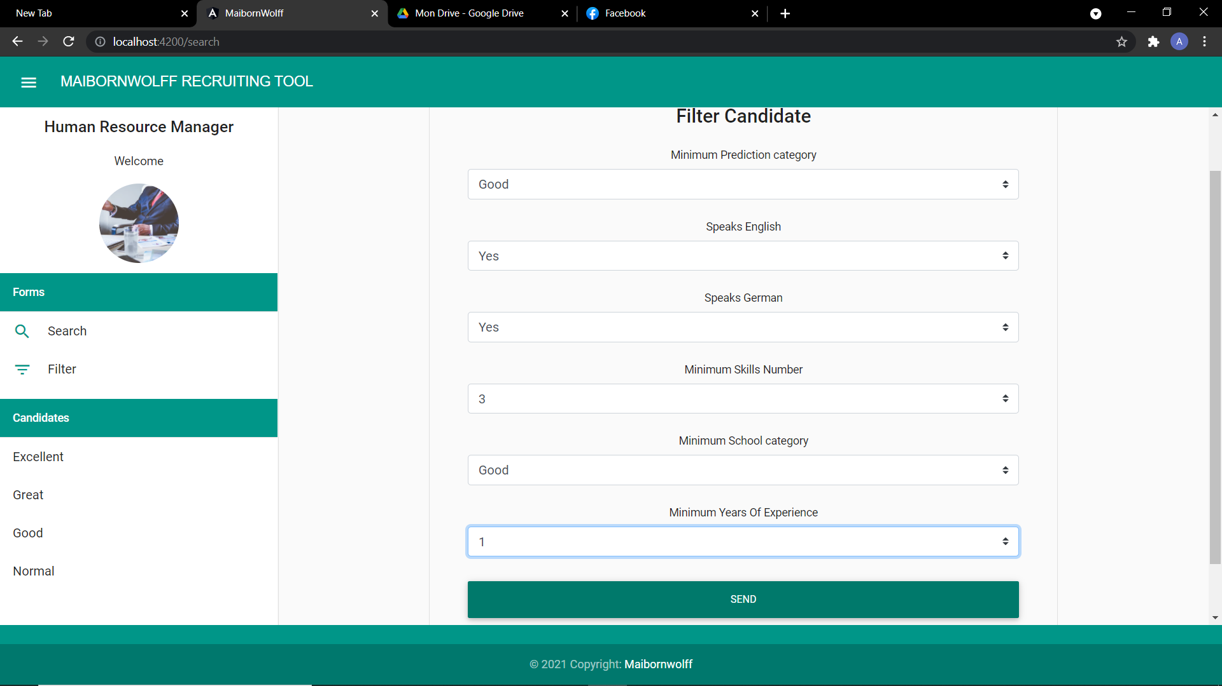
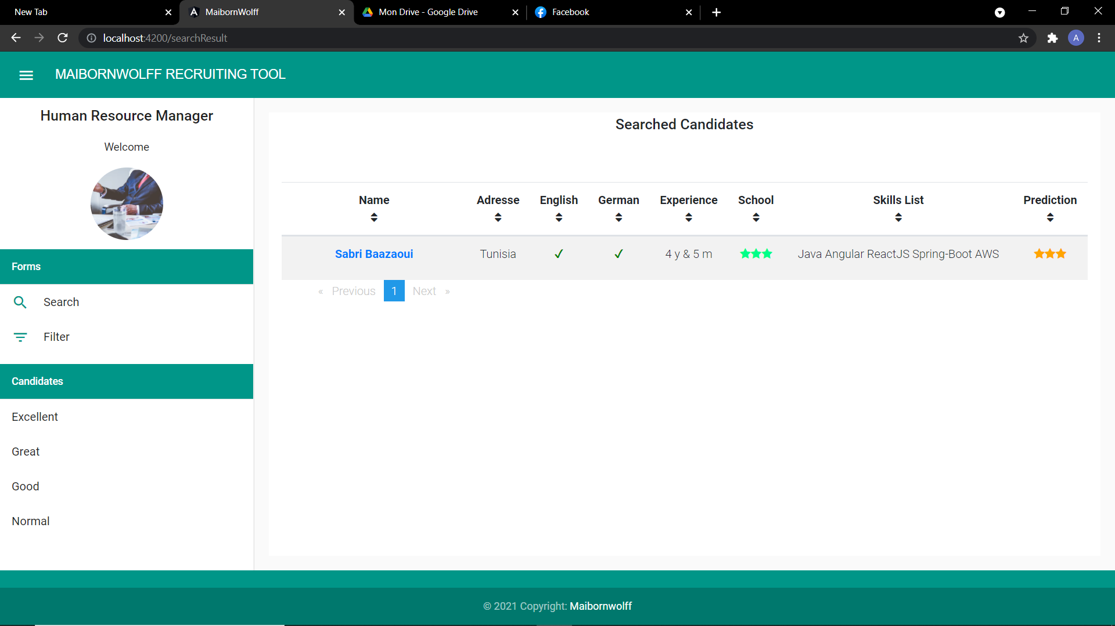
Realization
Filter candidates

Slide 32
Conclusion

Slide 33
Conclusion
Additions
Discover various technologies.
Discover the professional world and boost my communication skills at a professional level
Perspectives
Add the ability to recruit Non-IT
Ability to predict basing on soft skills.
Discover “Clean code”, “web scraping” and “machine learning”

Slide 34
Thanks!!
Notes:
Thanks for your attention

